Slide 1

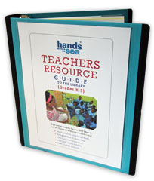

Teacher’s Resource Guide to the Library
Notes:
The Teachers Resource Guide to the Library was designed to *reinforce and complement the principles of the *Early Learners Programme (ELP), and is here to *help you, as primary school teachers.

Slide 2
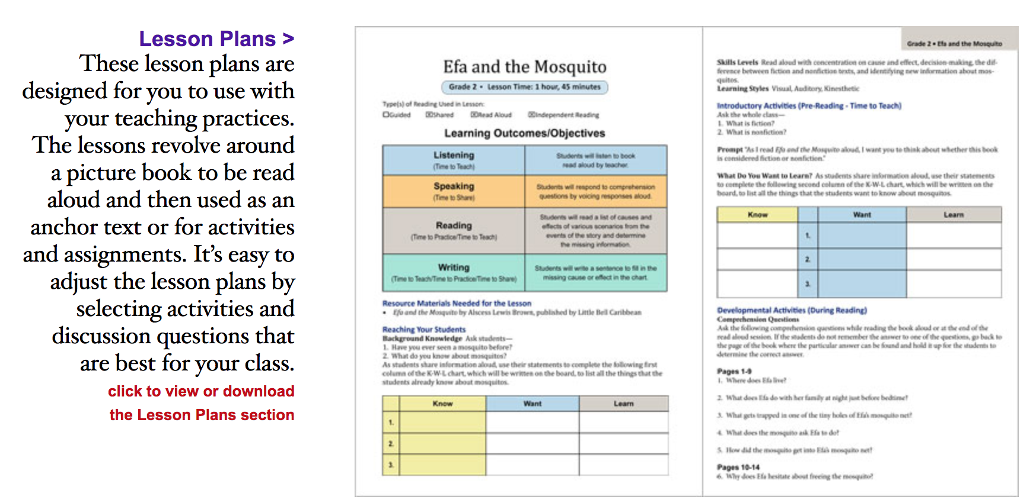
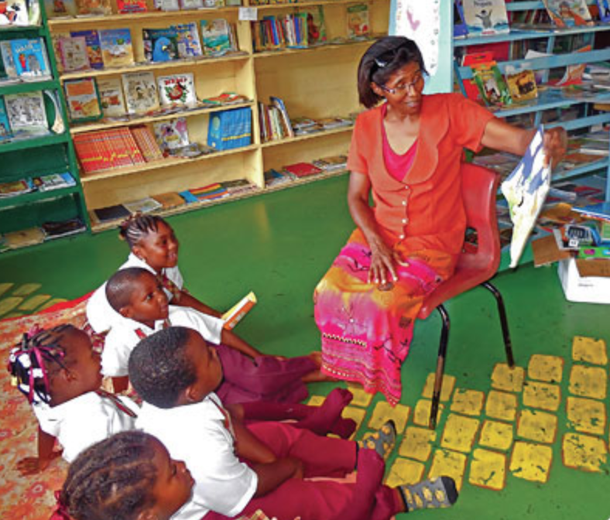
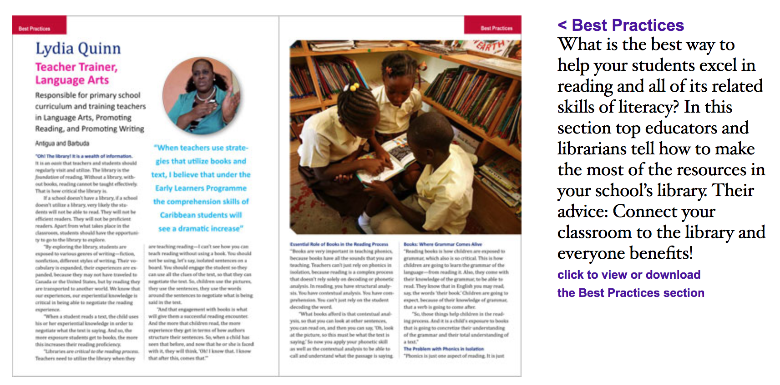

Teacher’s Resource Guide
Most primary school have received a Teachers Resource Guide to the Library (Grades K-3).
The Teachers Resource Guide is available for teachers in their school’s library.
The Teachers Resource Guide is for teachers to read and to USE with their students!
Notes:
Even though it was developed for Grades K-3, because of the ELP initiative, this resource gives tools and strategies for *all primary school teachers Grades K through 6 to connect the school library to your teaching of subjects across the curriculum to save you time and help your students excel. We encourage you to adopt the *lesson ideas in this guide that work for you and to add your own expertise, *best practices, and teaching materials to this guide.
Please feel free to share everything with every teacher at your school! In 2018, Hands Across the Sea sent a TRG to most primary schools in the six island countries that we work with. It should be available for you in your school’s library, and if not—*ask your principal or download your own free copy. The TRG is not meant to sit on a shelf collecting dust, it is meant to be read and used with your students. So let me show you how!

Slide 3
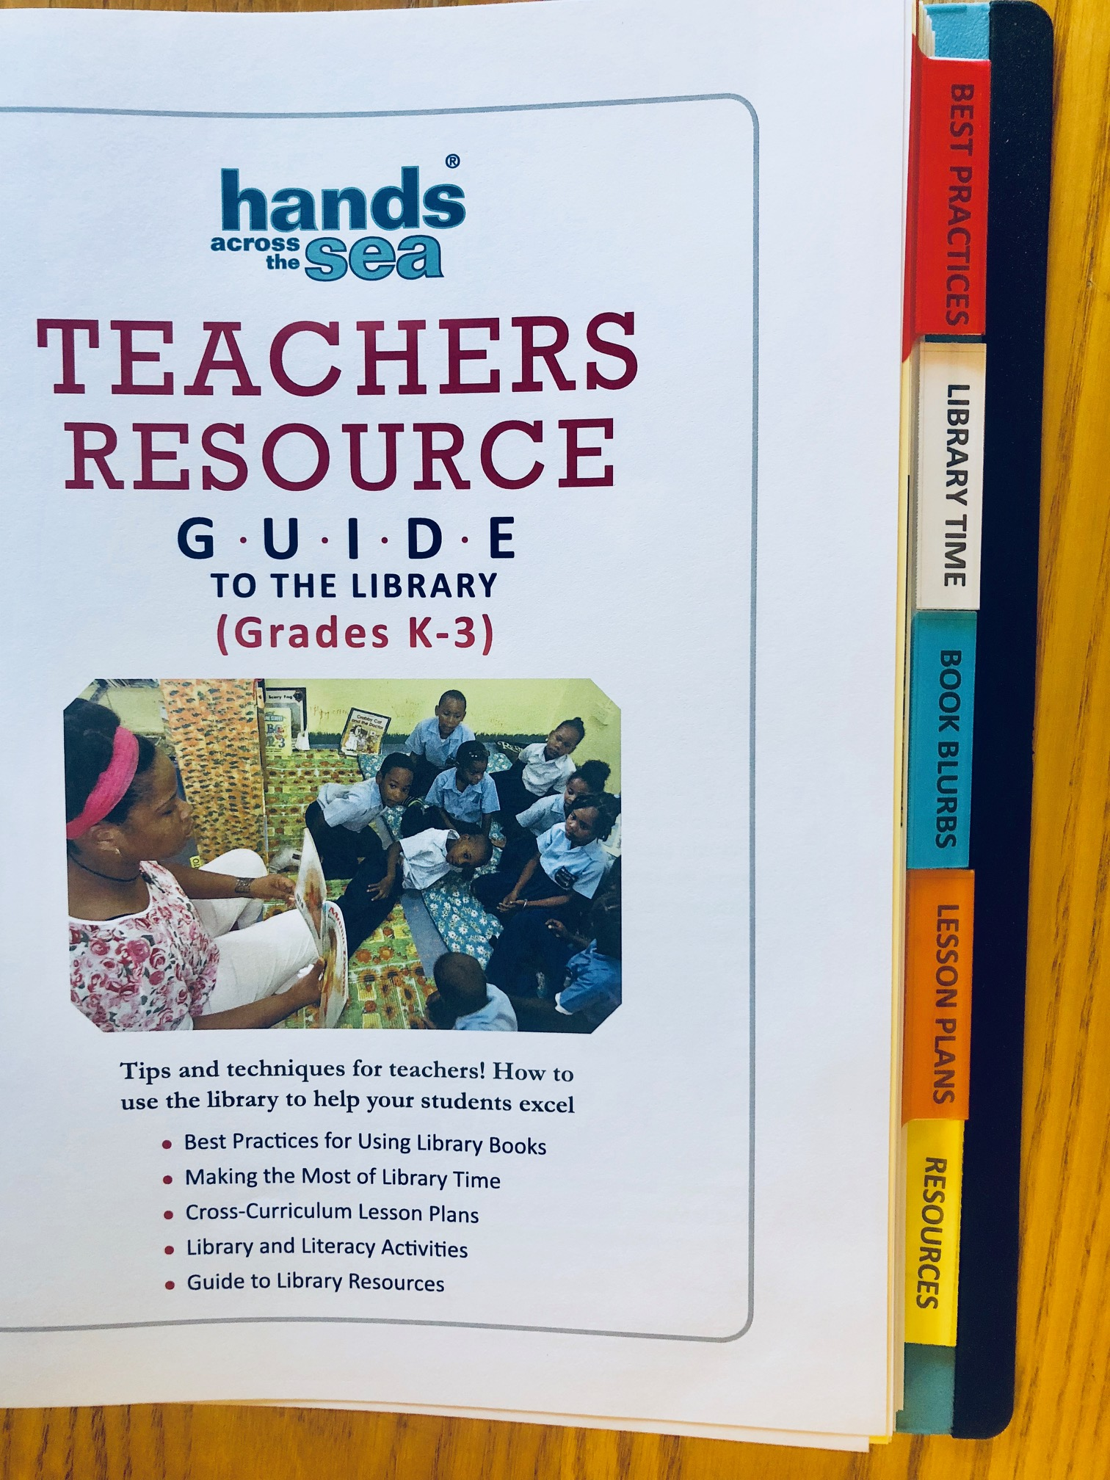
Organized into 5 Sections
Best Practices
Library Time
Book Blurbs
Lesson Plans
Resources
Notes:
The Teachers Resource Guide is organized into five sections: 1) Best Practices, 2) Library Time, 3) Book Blurbs, 4) Lesson Plans, and 5) Resources. I am going to be showing you a “sneak peak” of each section and what you can expect to find in each!

Slide 4
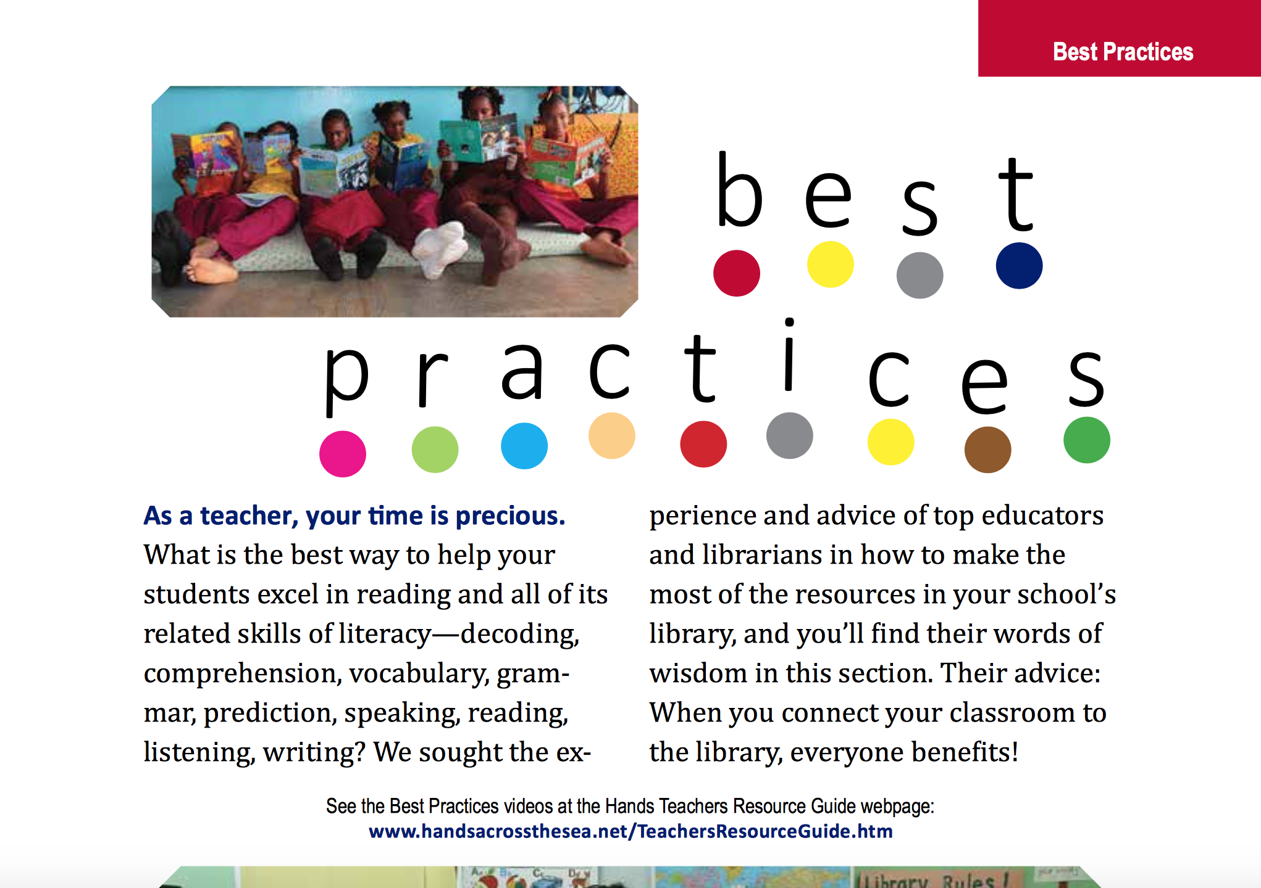

Notes:
*The Best Practices section has interviews of teachers and librarians from different islands in the Caribbean sharing their ideas of how they use the library and what has worked best for them! Let me show you some examples!

Slide 5
Notes:
*Teachers like Lydia Quinn, in Antigua, explains what is working for her and her school through the library program. She shares ideas about the essential role of books in the reading process, how teachers can teach grammar through the use of reading books, and how teaching phonics using books is much more effective than teaching it in isolation! Let me show you a few others!

Slide 6
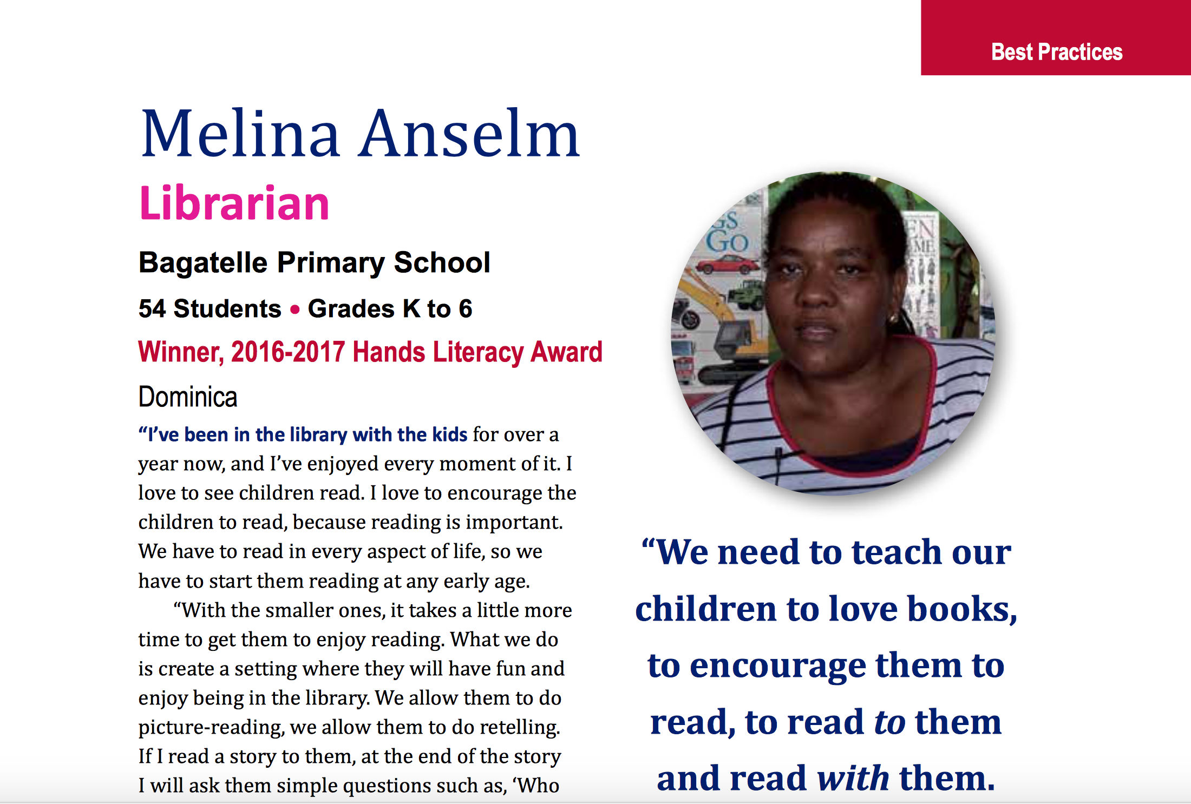
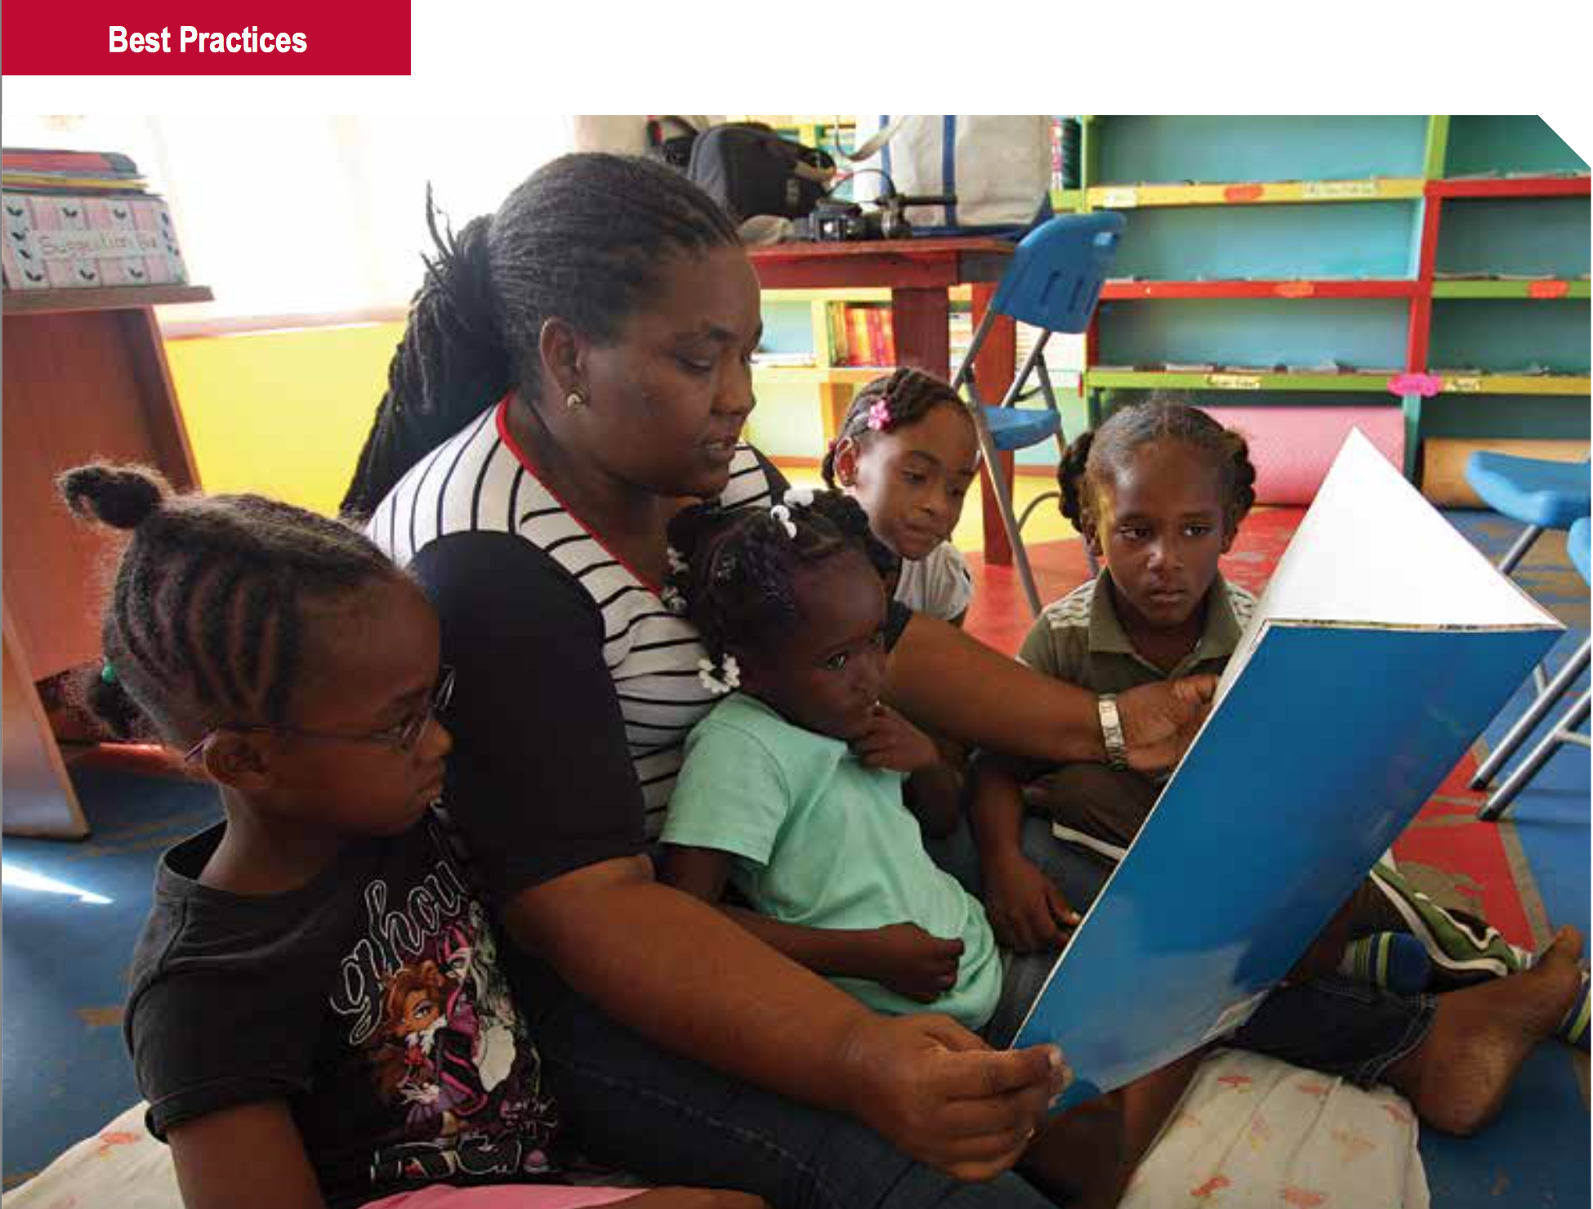
Notes:
*Here is Melina Anselm, a librarian at Bagatelle Primary School in Dominica. She shares the importance of teaching our children to love books and to read TO them and WITH them.

Slide 7
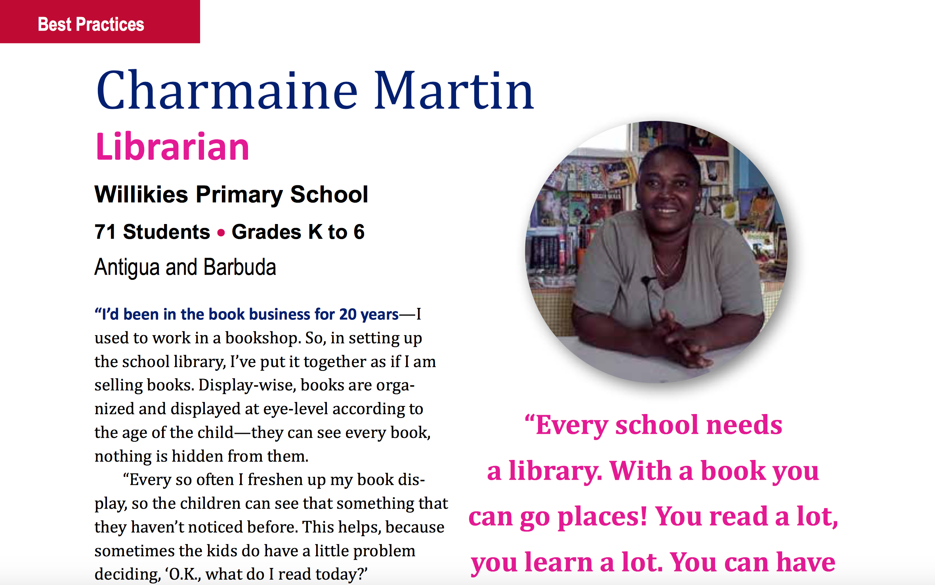
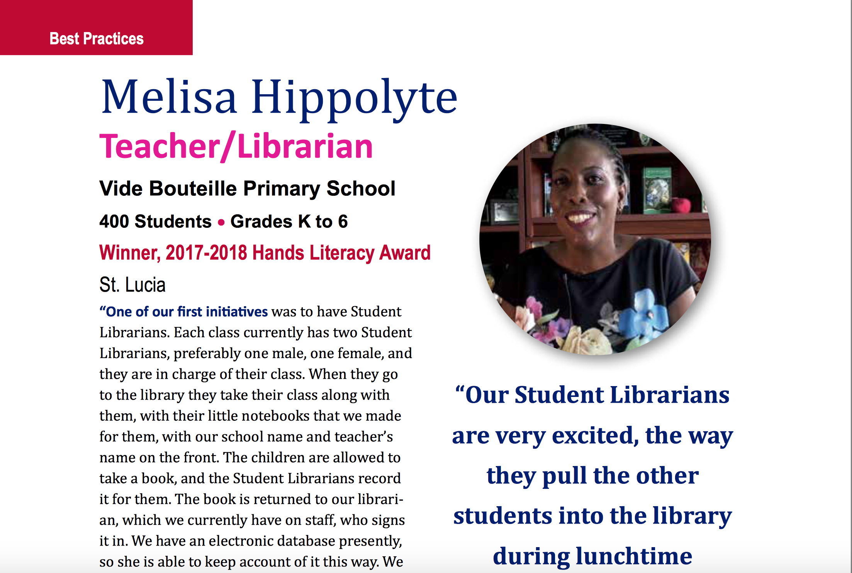
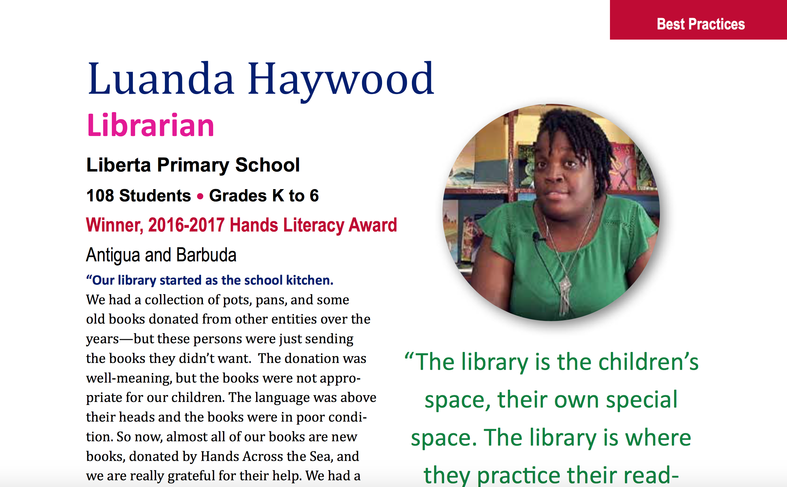
Notes:
Melissa Hippolyte is a Teacher and Librarian in St. Lucia, and she shares how the Student Librarian Program at her school took a few tries to really succeed, but in the end it was worth it! *Luanda Haywood from Liberta Primary School discusses what the student librarians at her school contribute. And *Charmaine Martin from Willikies Primary shares how she collaborates with the teachers at her school to find books from the library that help with their specific lesson plans.

Slide 8
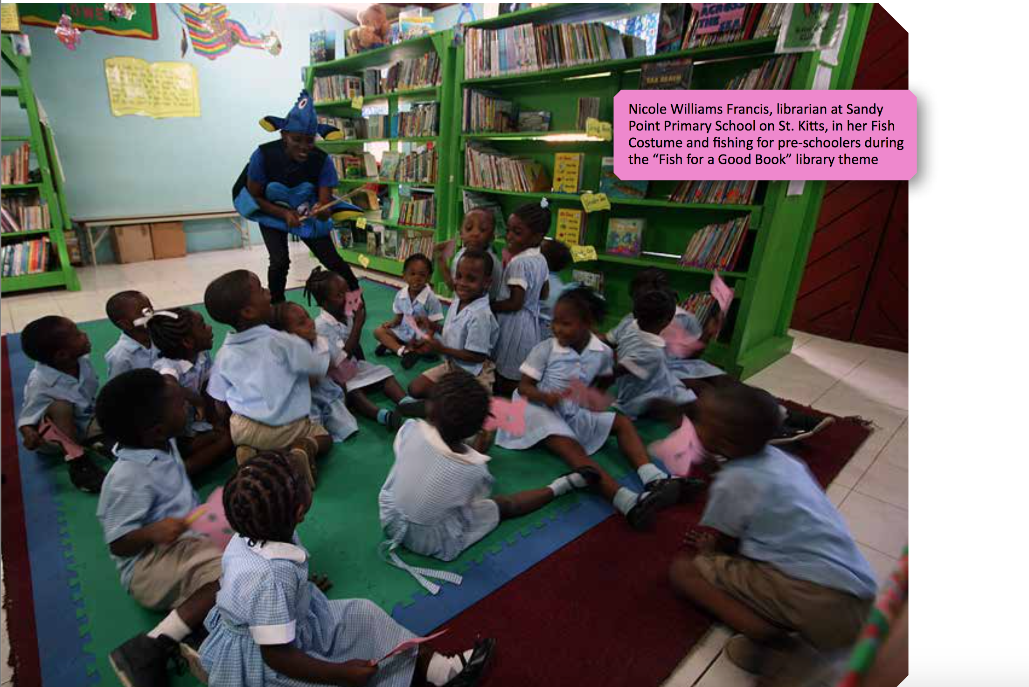
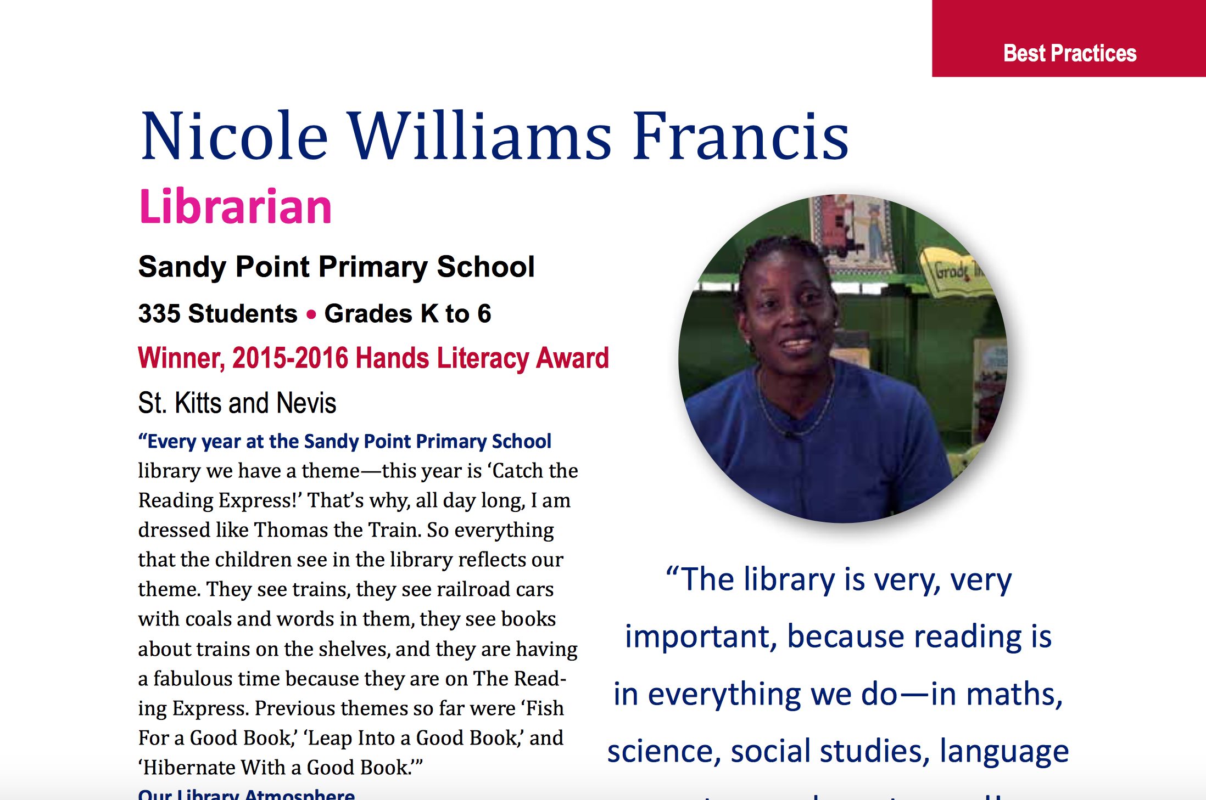
Notes:
*The idea behind the best practices section is to encourage teachers and librarians that if those in the interviews can do it, they can too! Here Nicole Francis from St. Kitts shares about the creative things she does in the library to get students excited about reading, and she’s done some pretty crazy things—like dressing up as a fish for her library theme called “Fish for a Good Book.” I am going to pause now and see if there is any feedback or questions you have.

Slide 9
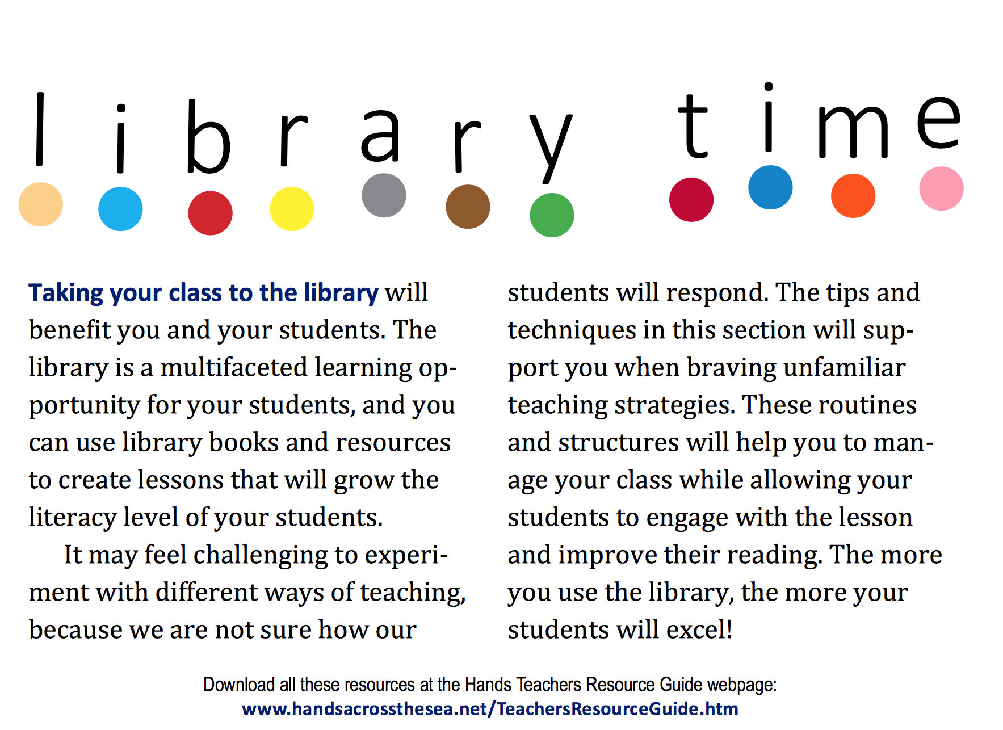
Notes:
*Library time is the next section in the Teachers Resource Guide.

Slide 10
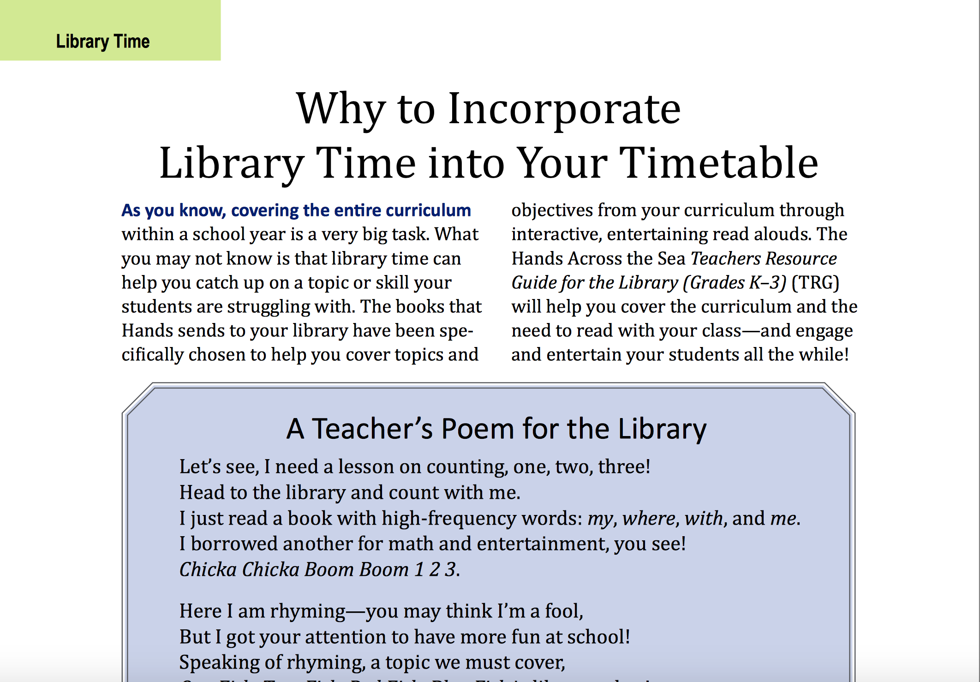
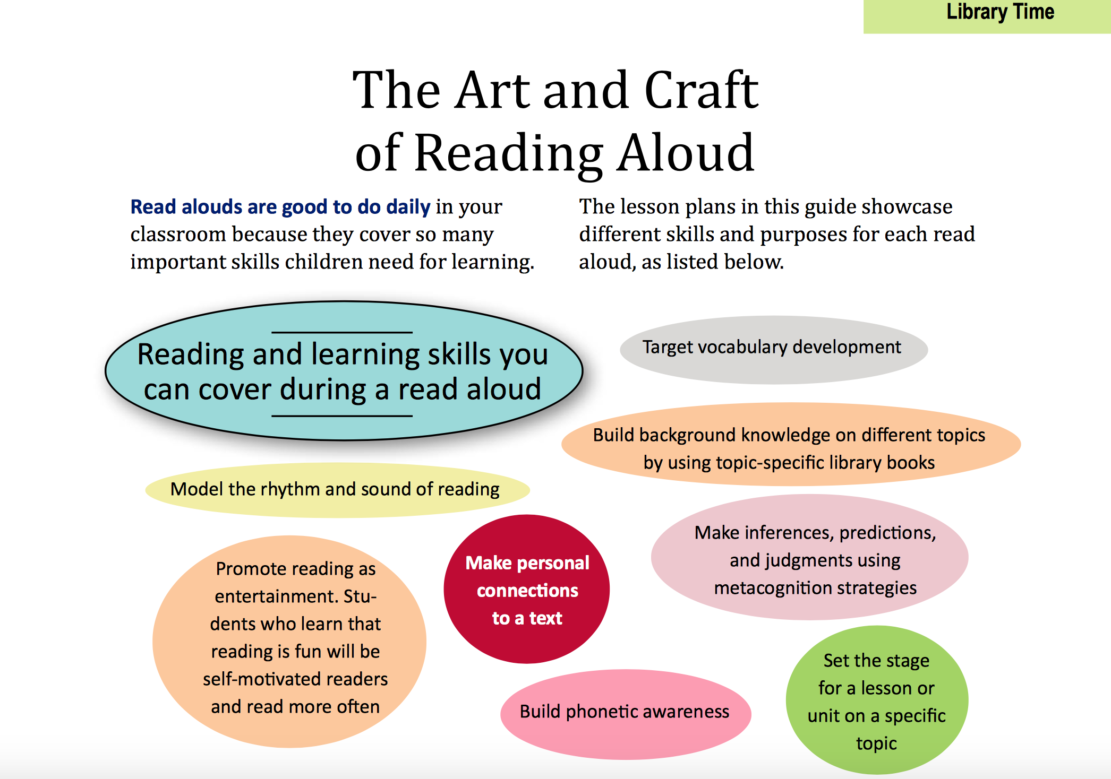
Notes:
*Library Time includes why incorporating Library Time into the Timetable is so valuable, because it IS teaching time. *It shows how the art and craft of reading aloud to students is important and establishes skills that are within the curriculum. Several helpful tips are suggested to make Read Alouds fun and enjoyable for students as well as comfortable and practical for the teacher.

Slide 11
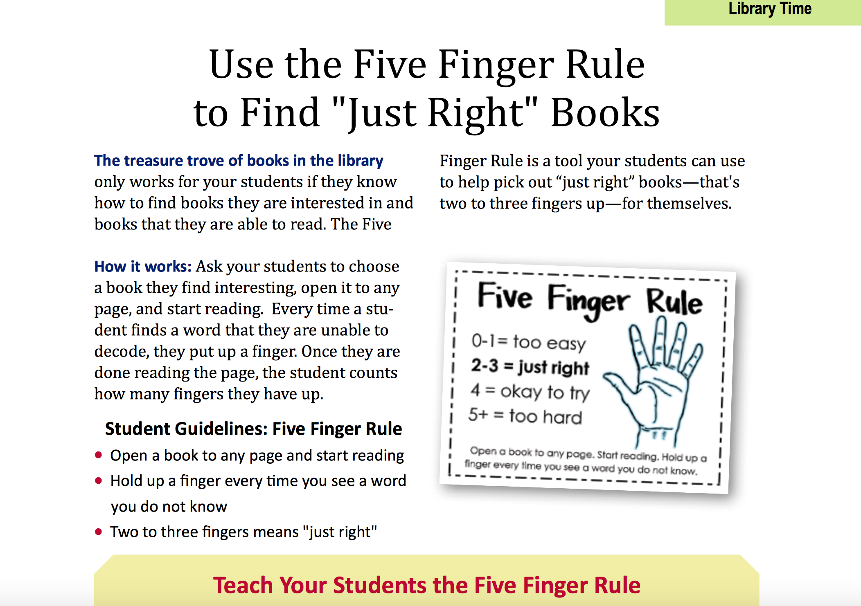
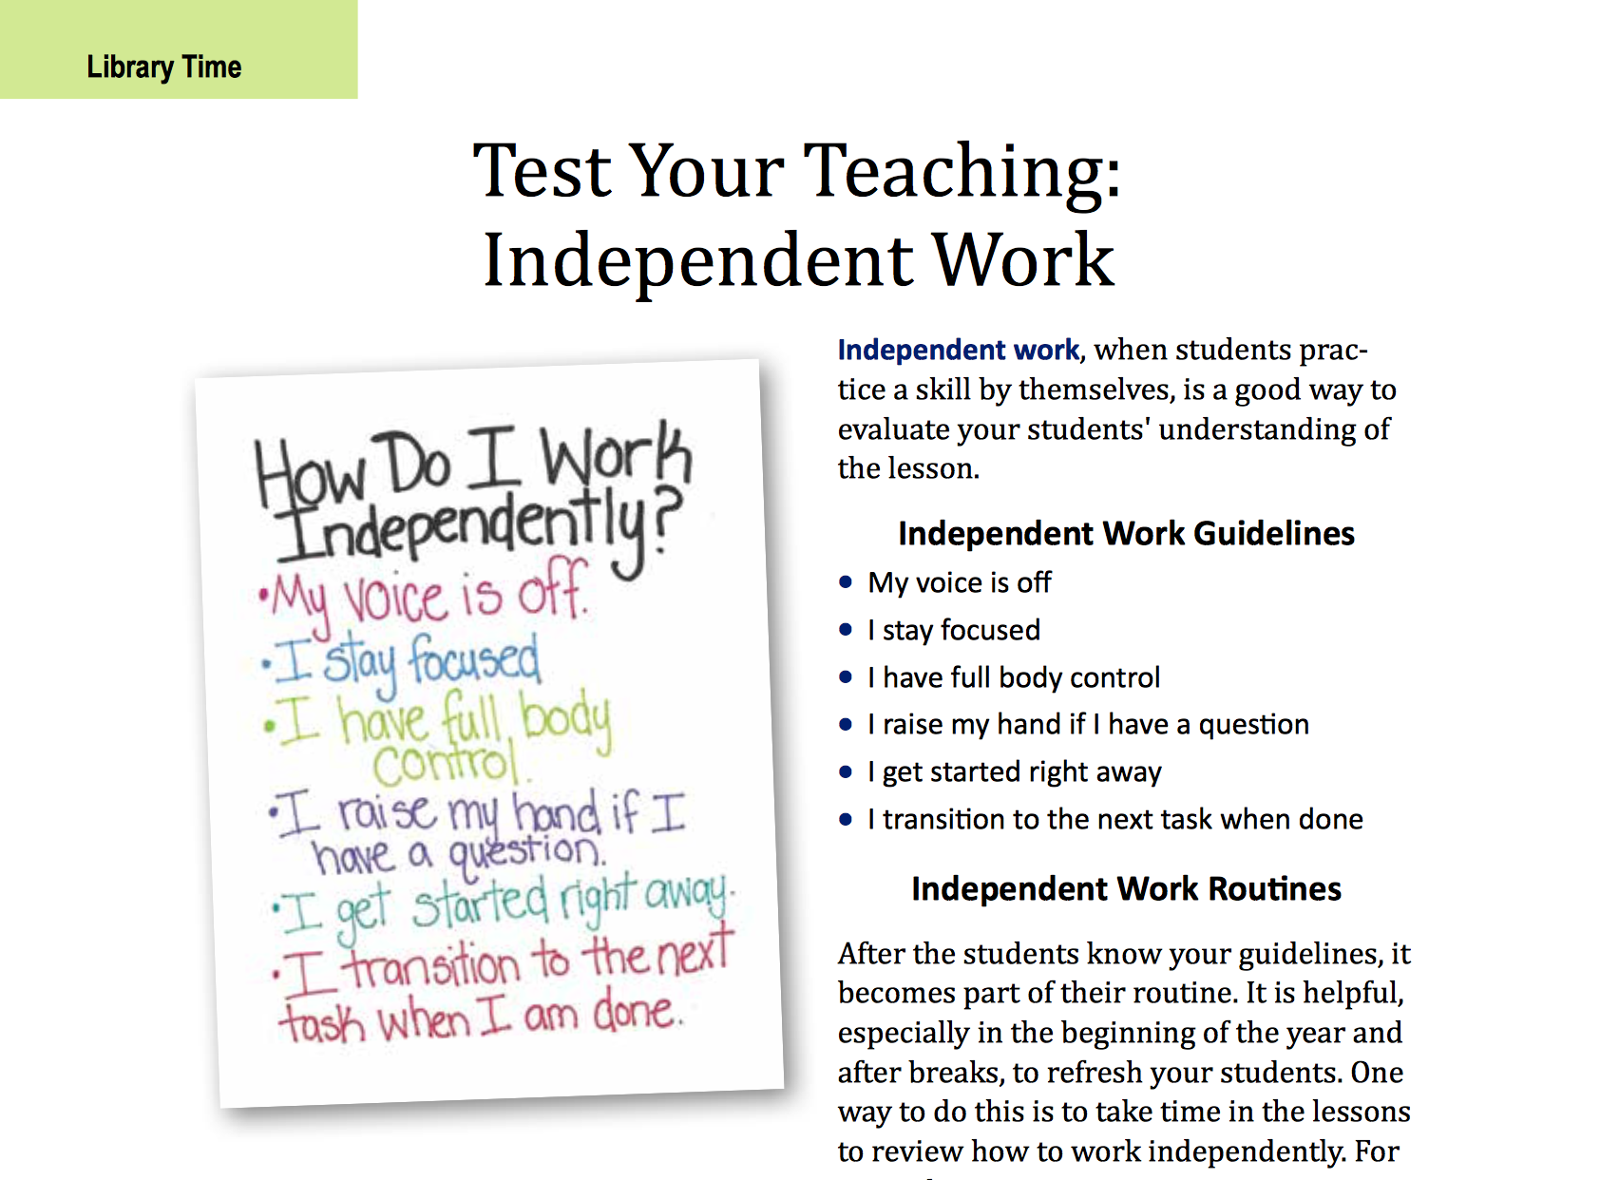
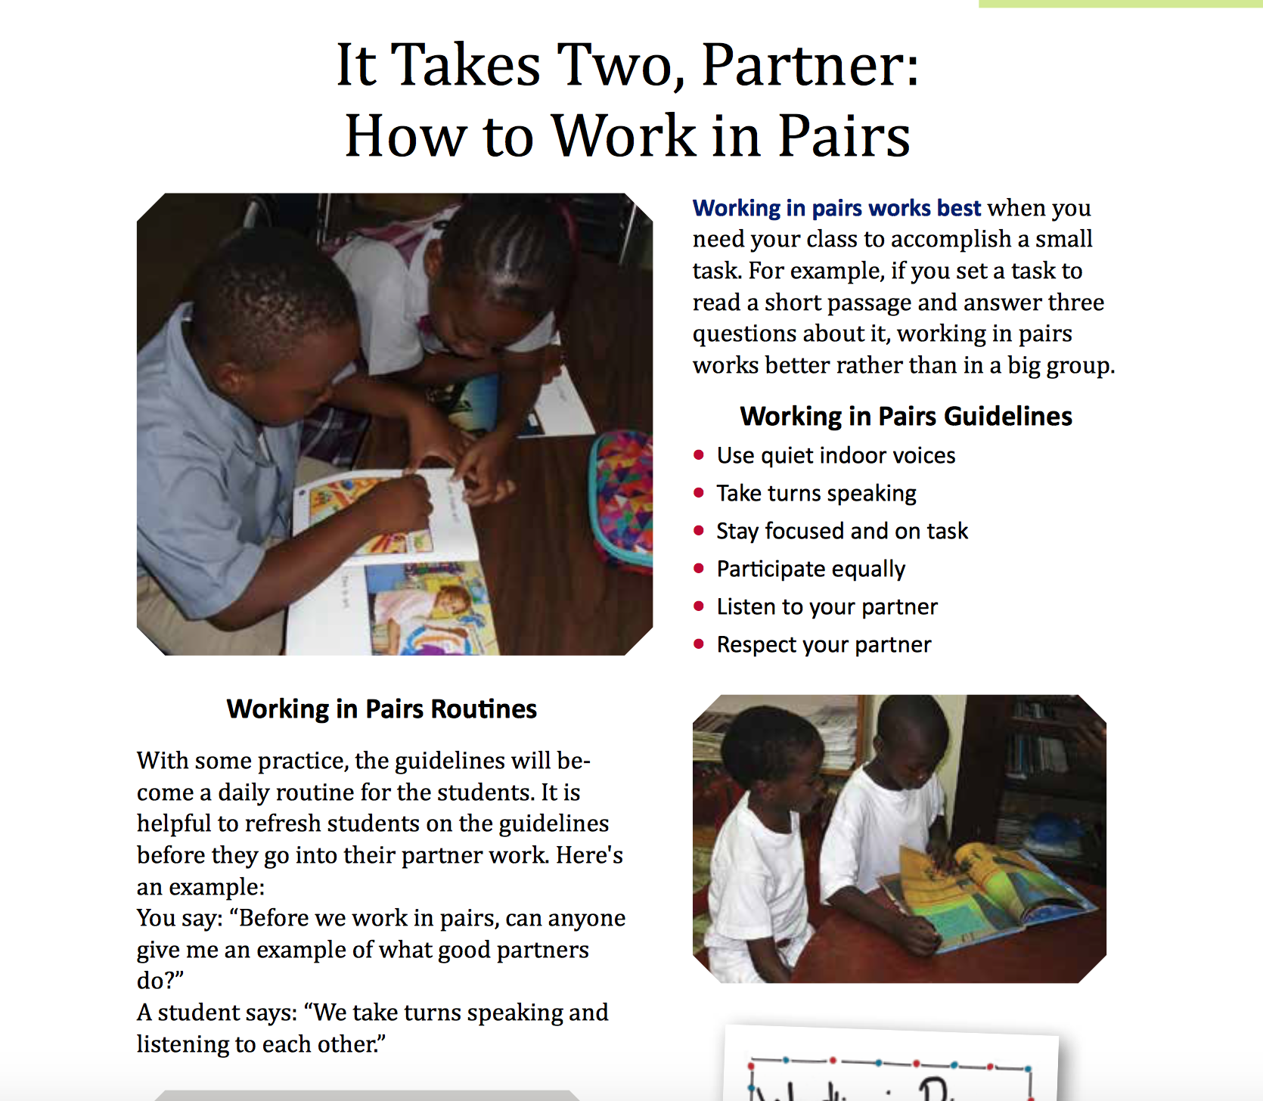
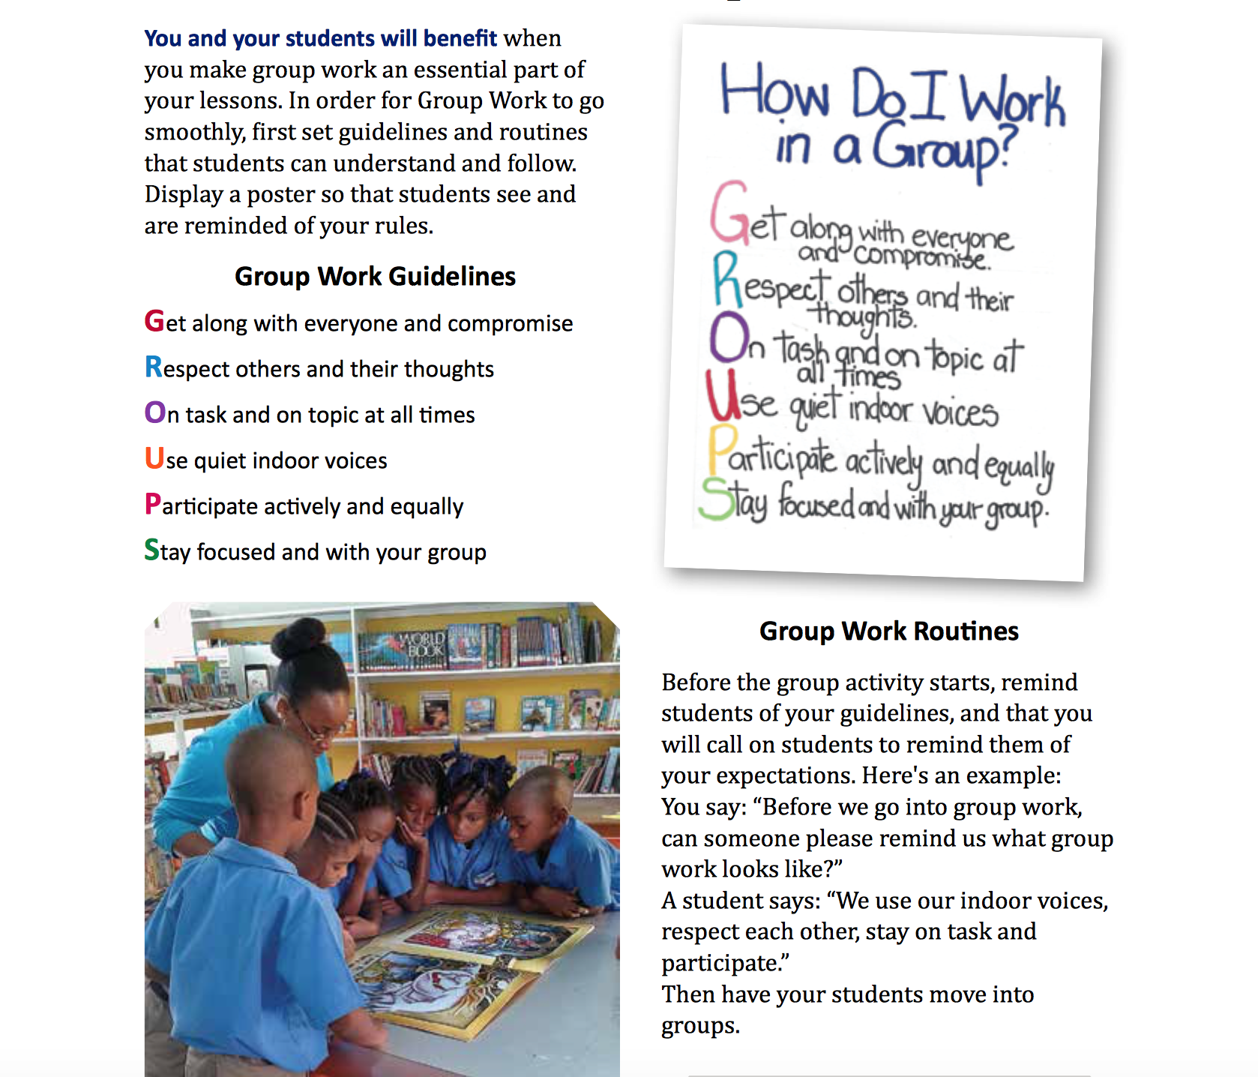
Notes:
*Teachers can use a strategy called the Five Finger Rule will help students find “just the right” books on their own for their reading level! *This section also gives suggestions for how teachers can manage their students when working in groups with easy acronyms and poster ideas that you can display in your classroom as reminders. *Guidelines for working in pairs are listed as well as how to *best work independently.

Slide 12
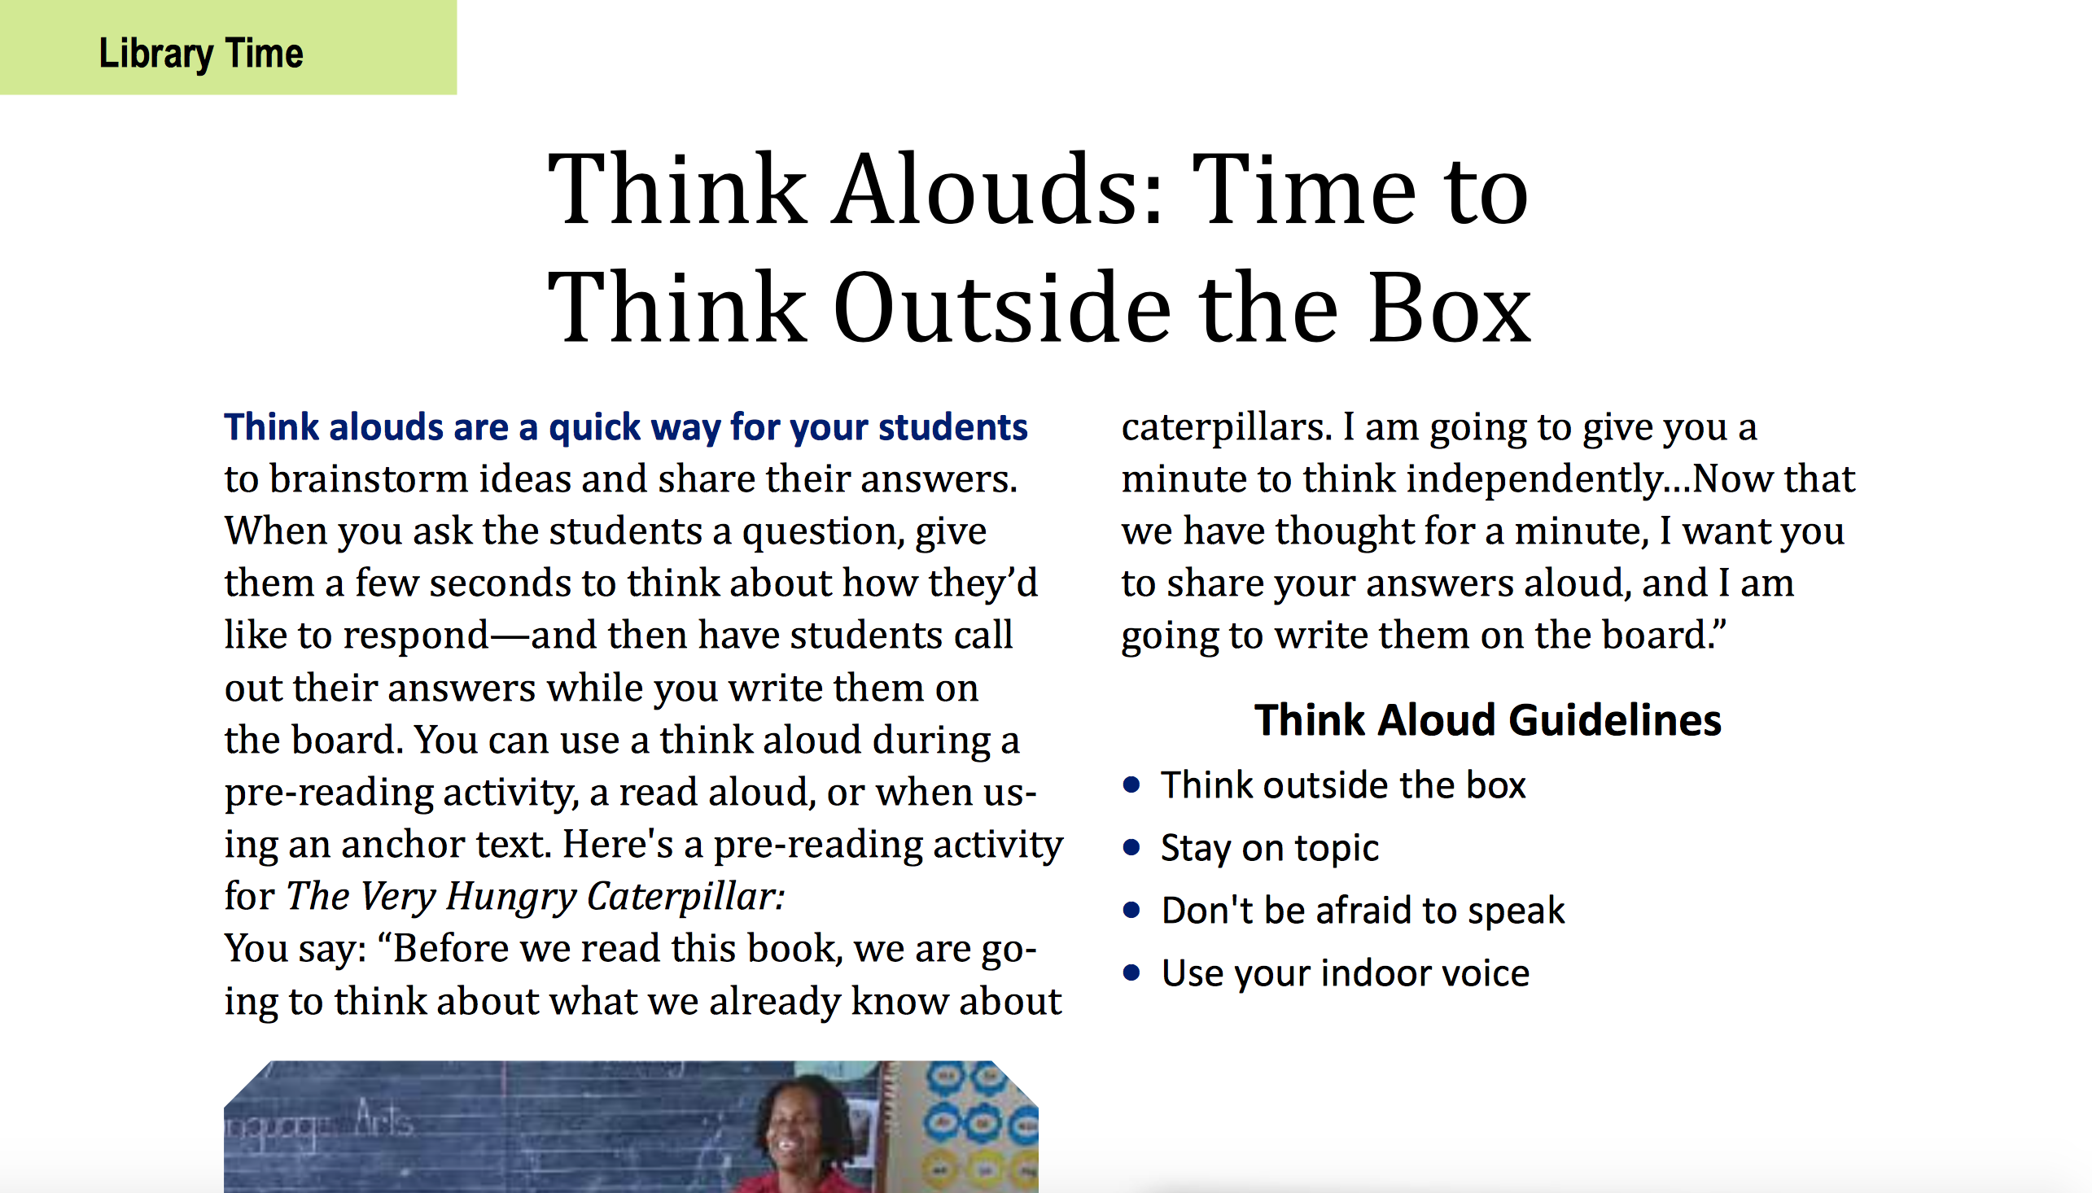
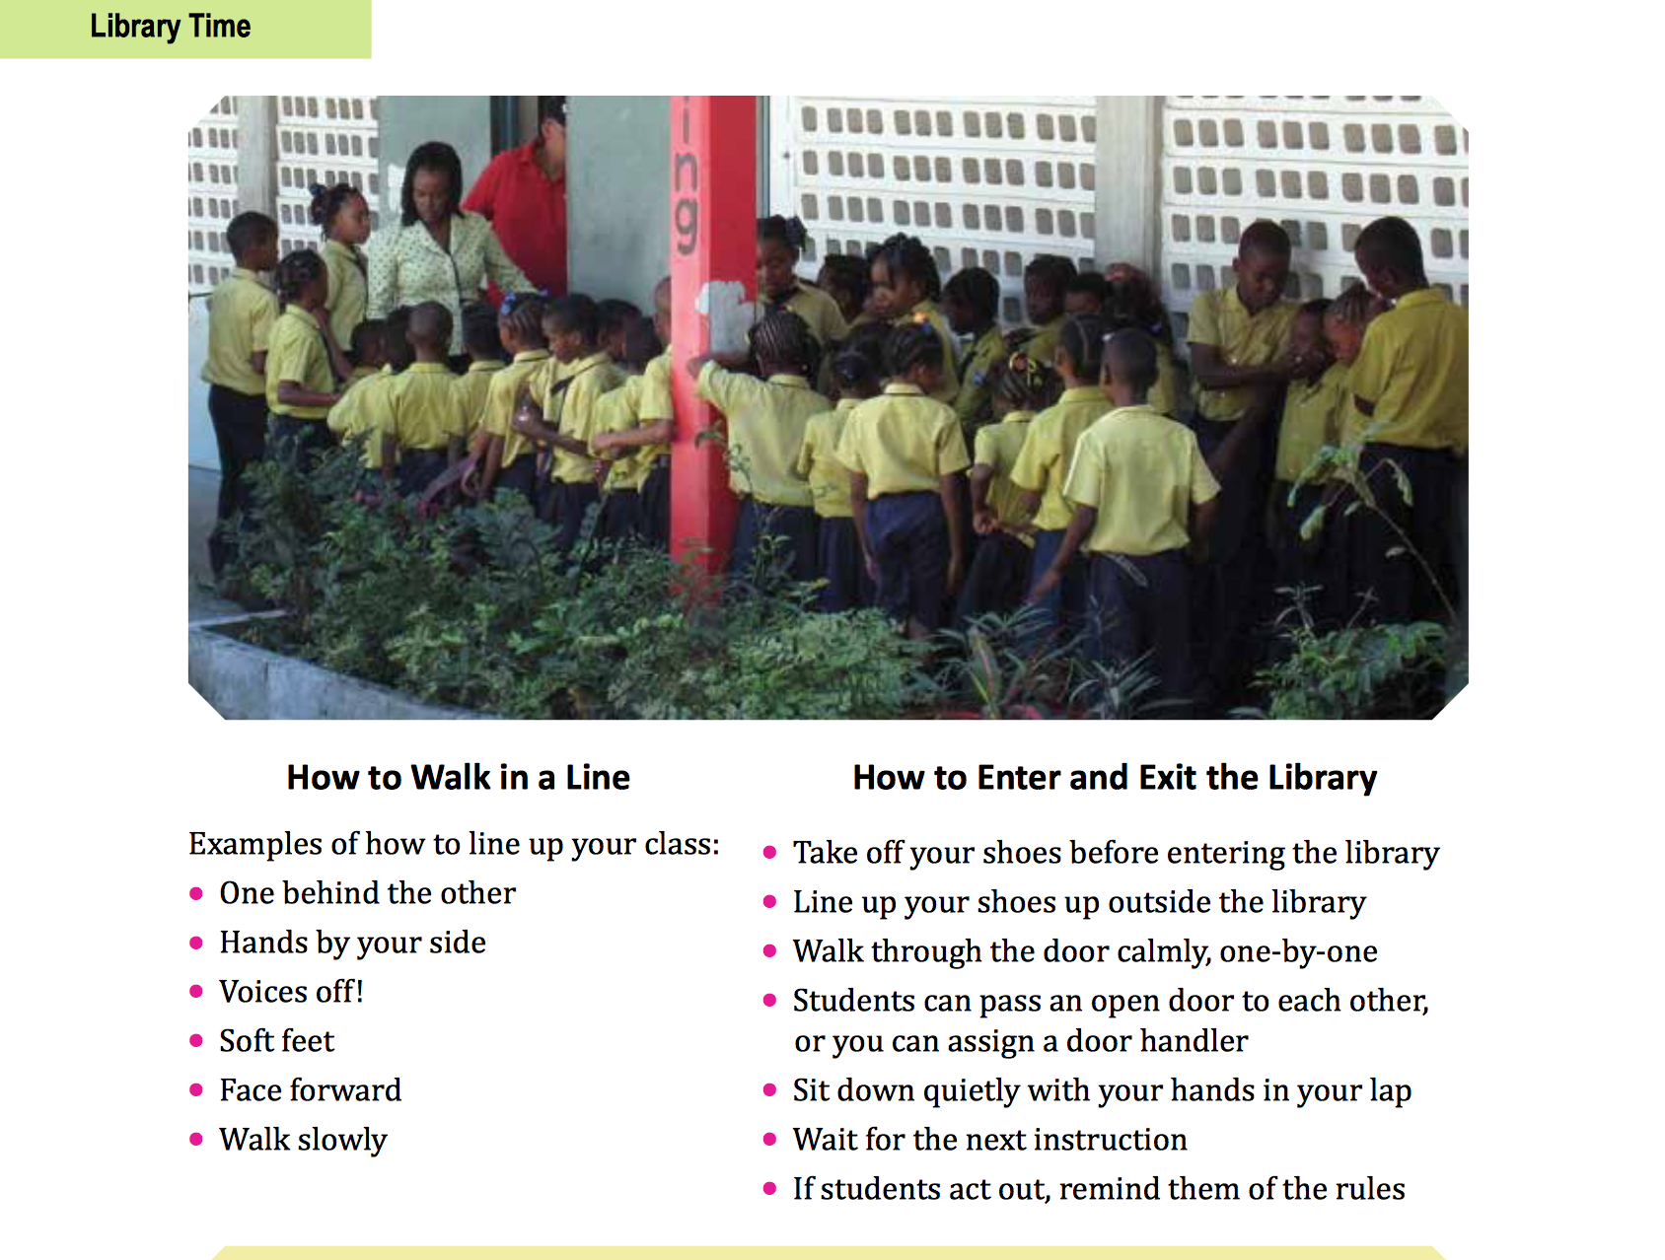
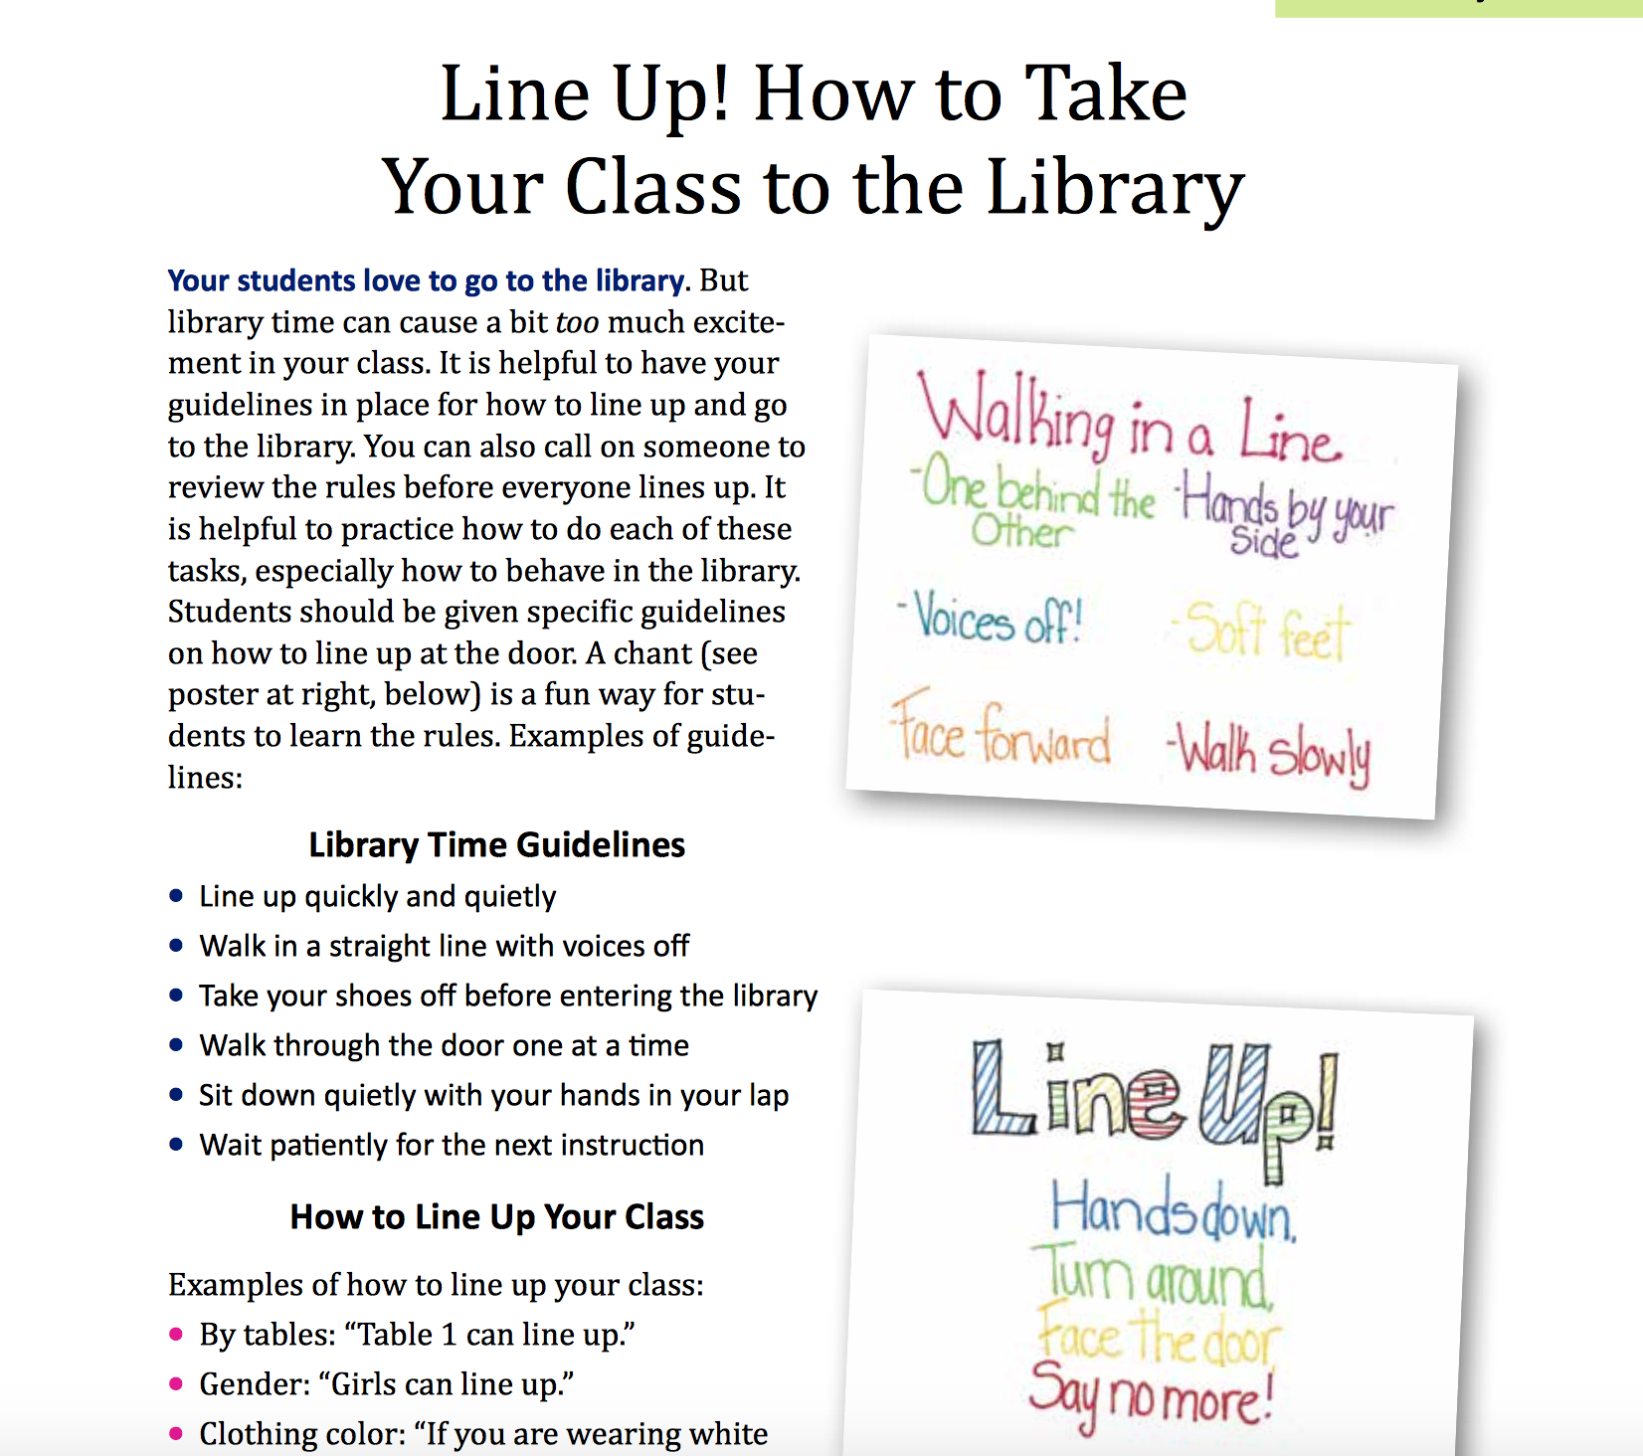
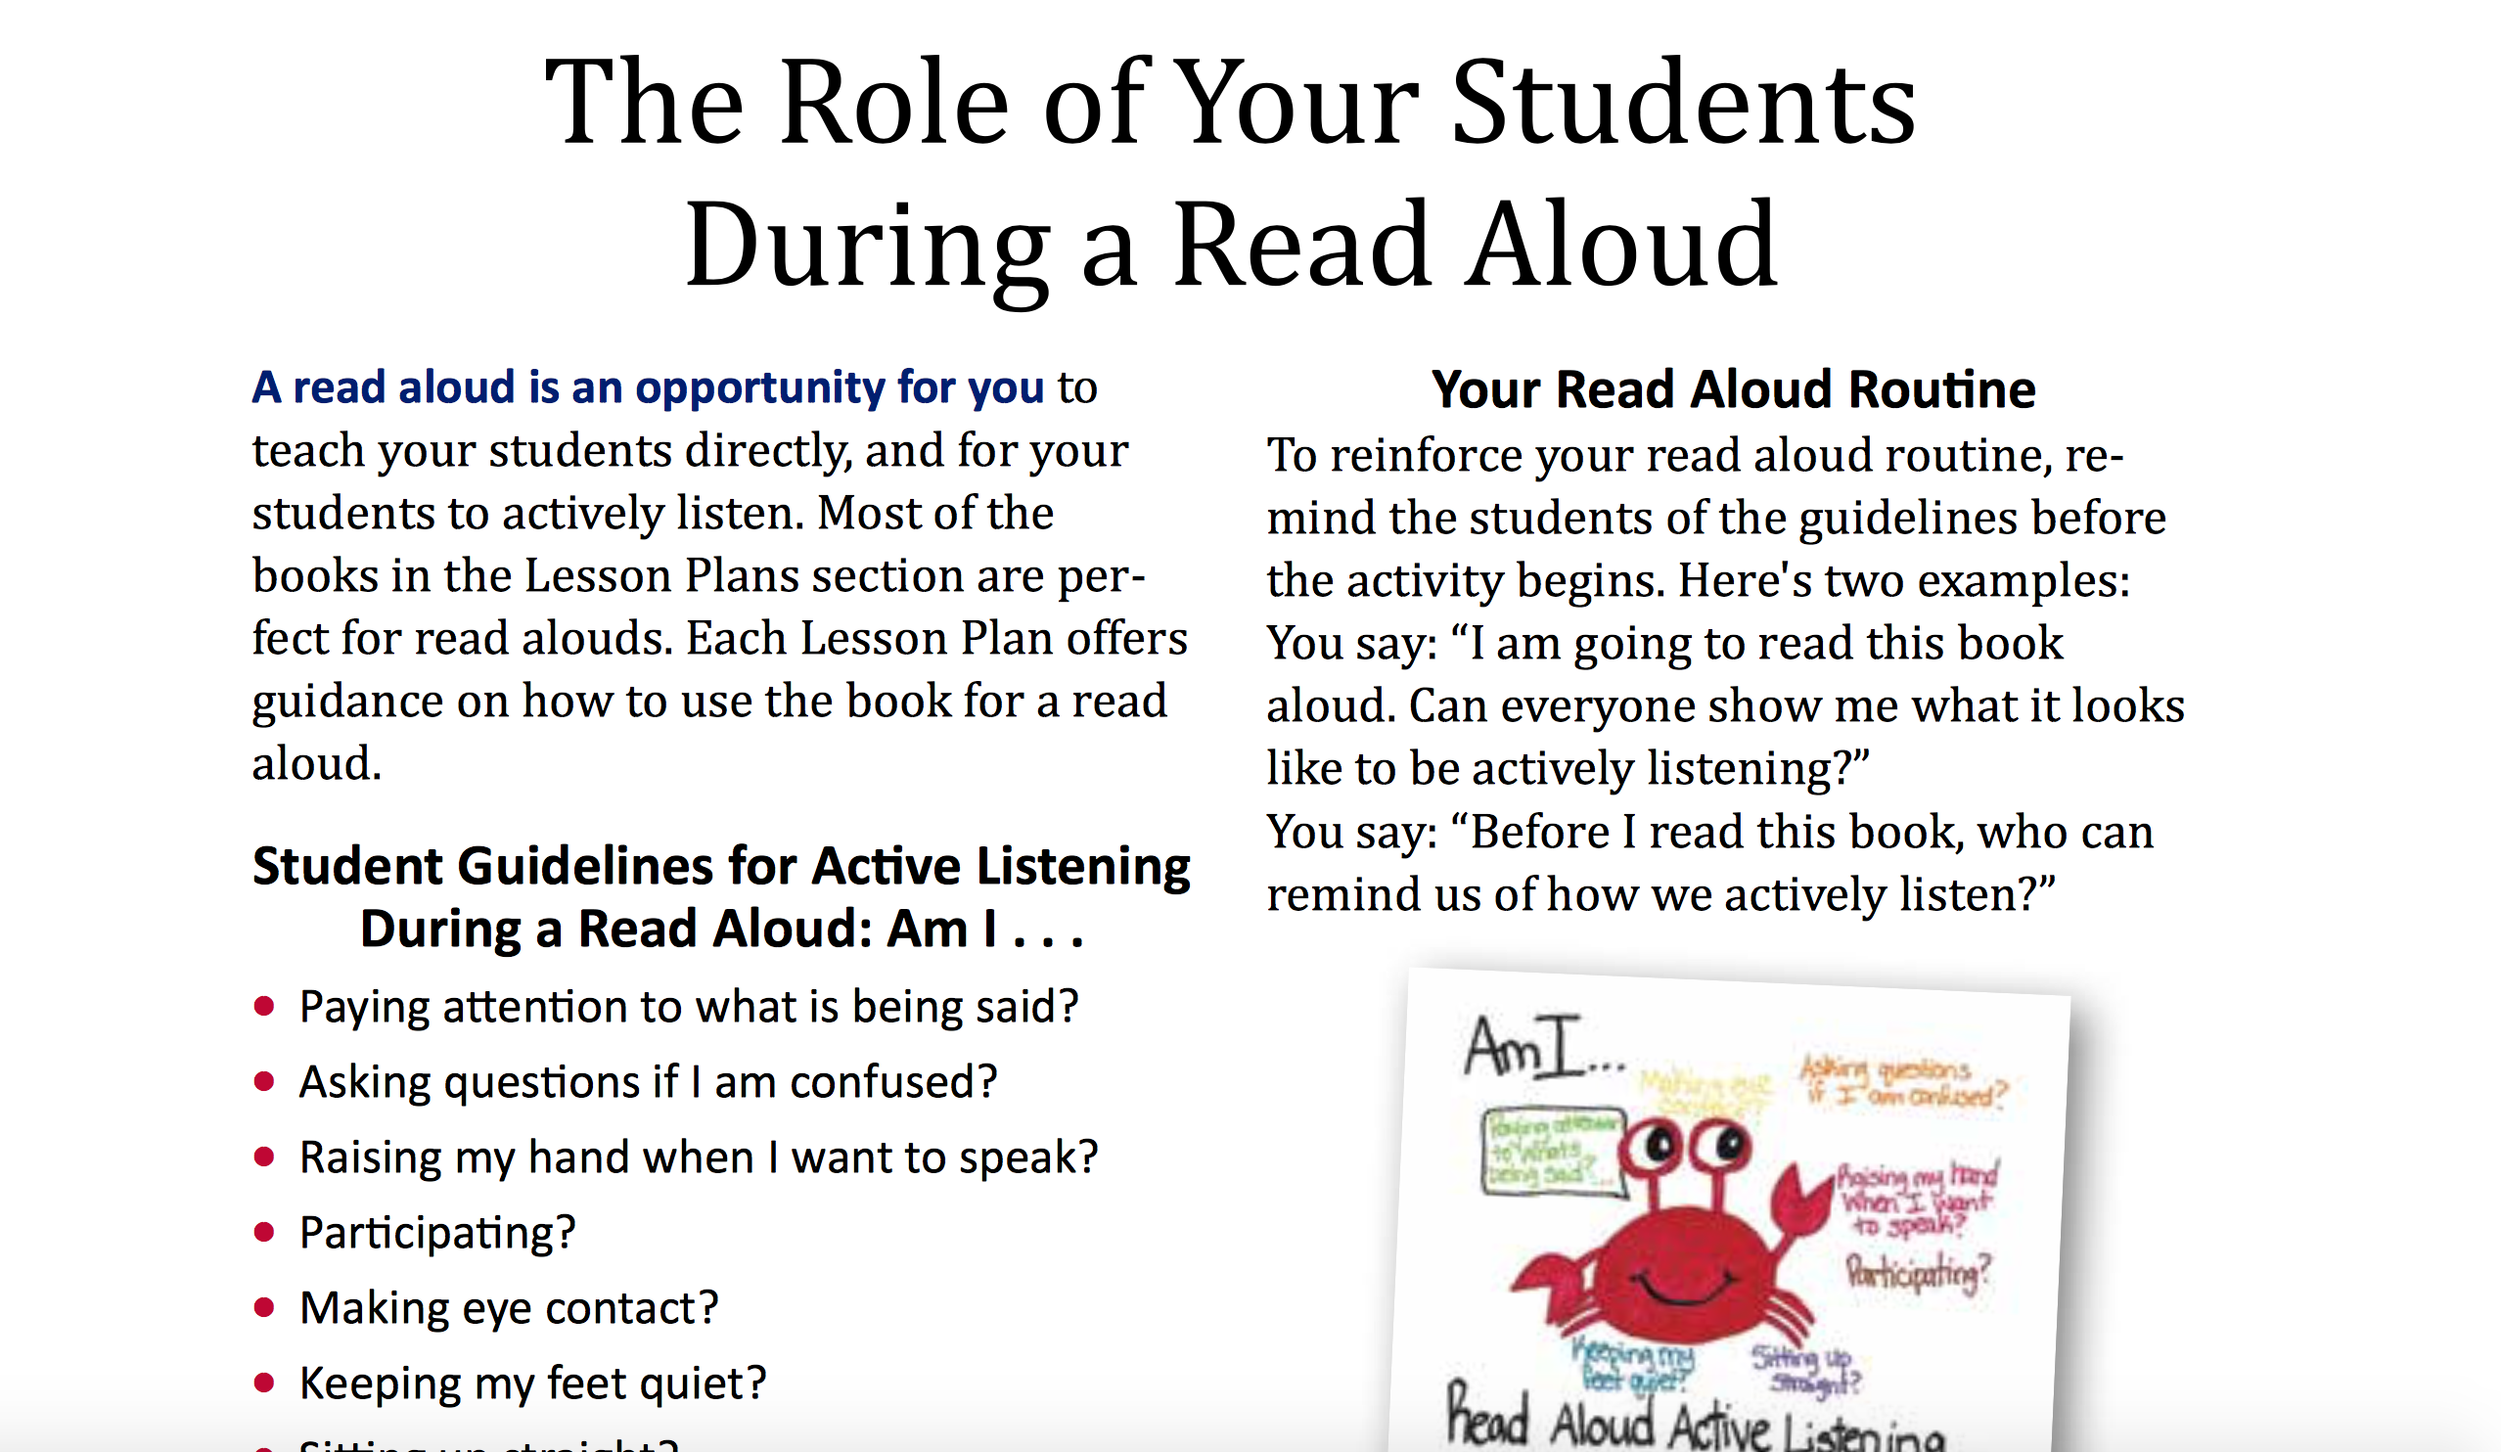
Notes:
*Library Time also gives guidelines for taking a class to the library, how to line up a class, how to walk in a line, and how to enter and exit the library. It details what a read-aloud should look like and *what a “think-aloud” is, so students can share quickly and freely, but teachers are still in control of the class.

Slide 13
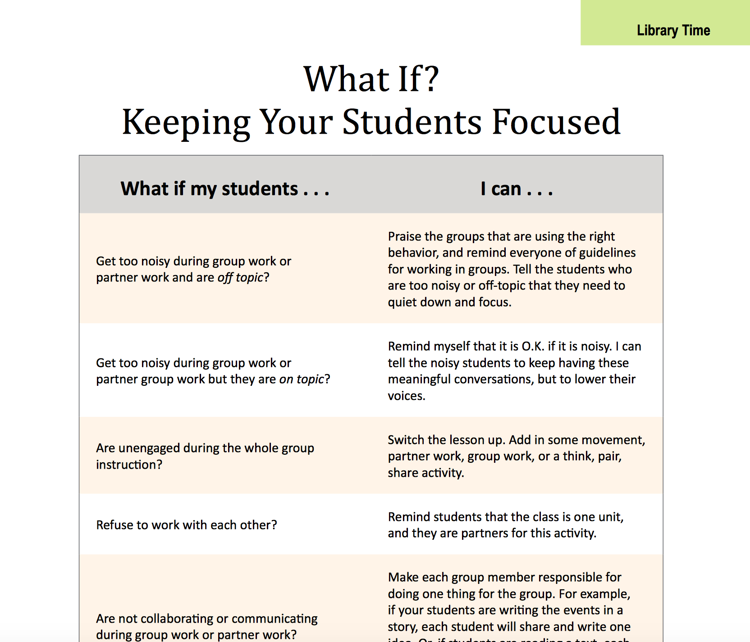
Notes:
Another unique page of this section is the What If? Table which lists strategies for troubleshooting…*what if my students get too noisy during group work or partner work and are off topic? I can…praise the groups that are using the right behavior, and remind everyone of the guidelines for working in groups. I am going to pause now and see if there is any feedback or questions you have.

Slide 14
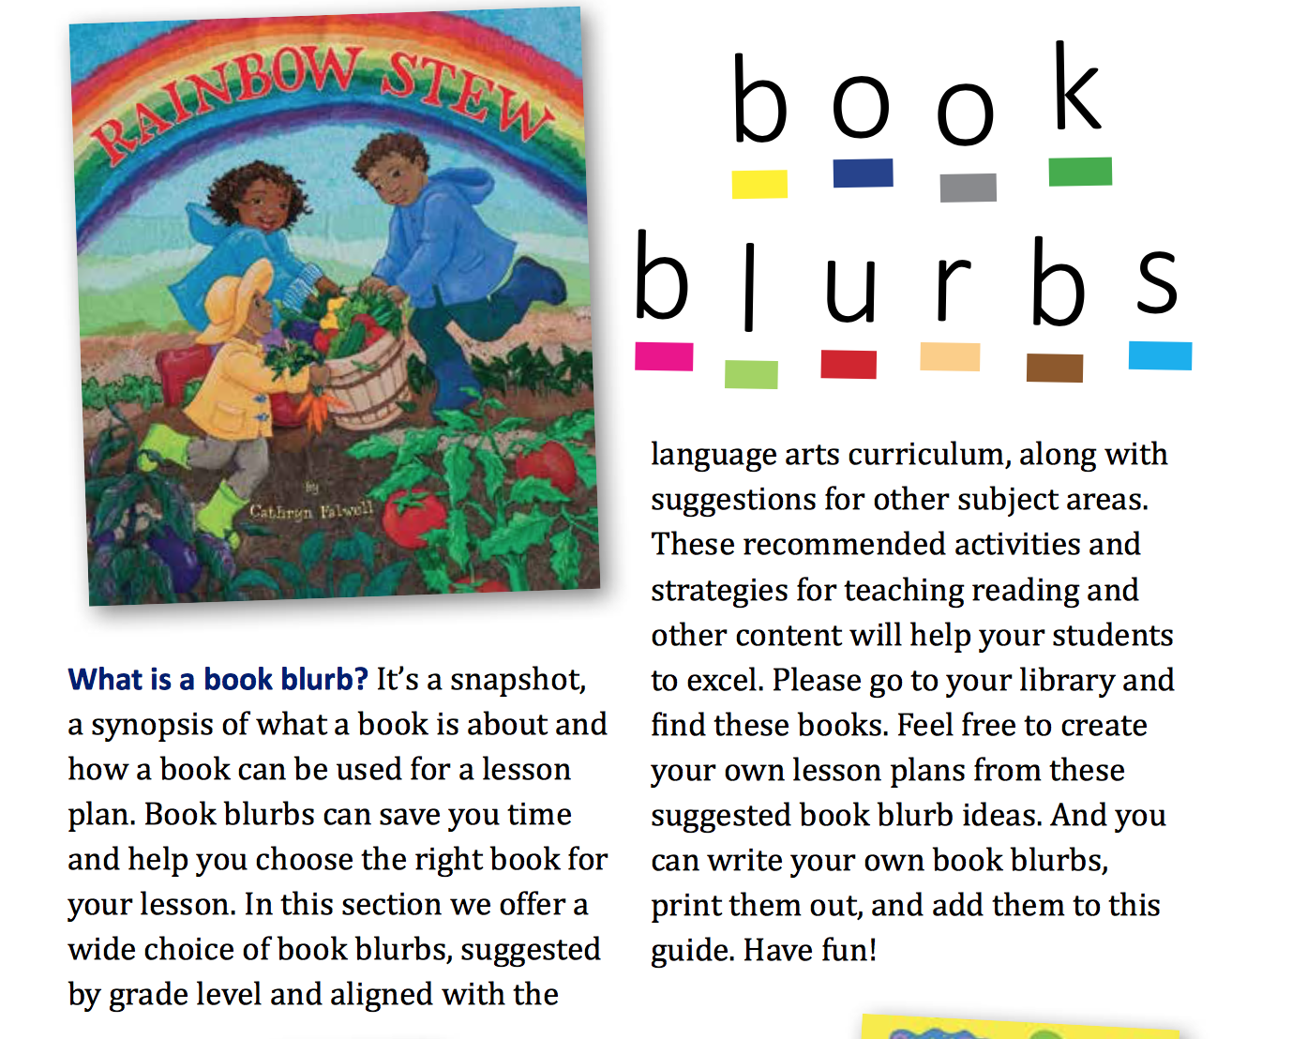
Notes:
*The third section of the Teachers Resource Guide is called Book Blurbs.

Slide 15
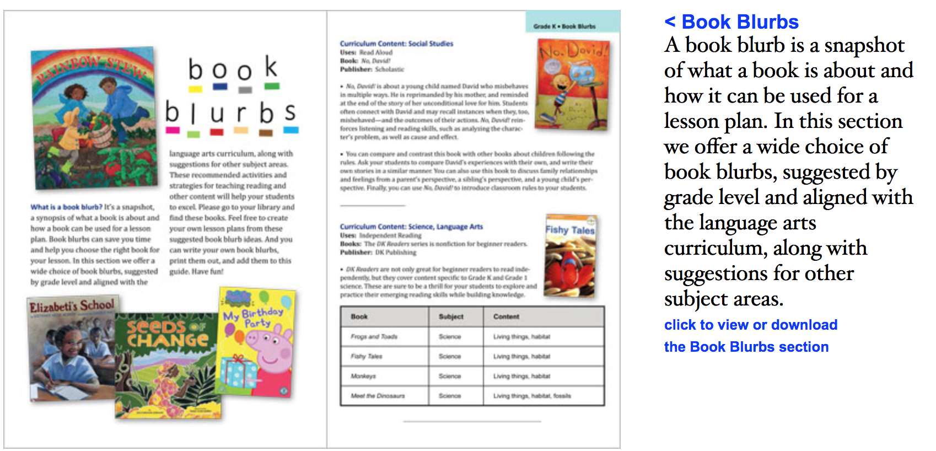
Notes:
*It lists many, many books that Hands Across the Sea has donated over the years to the school libraries and how teachers can easily use these books in their lessons for various curriculum topics!

Slide 16
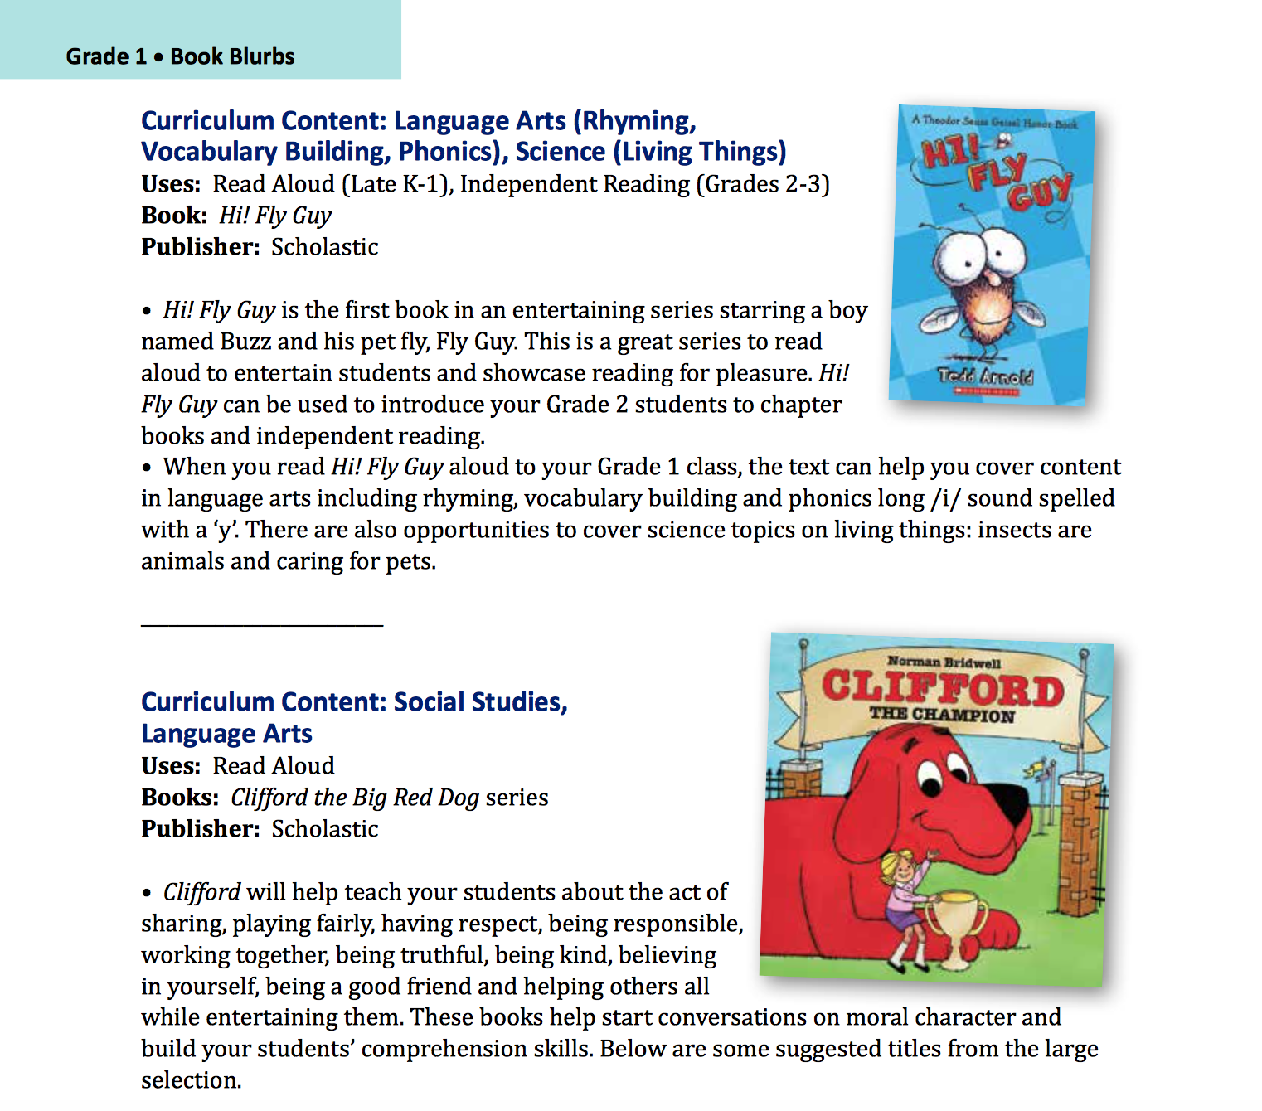
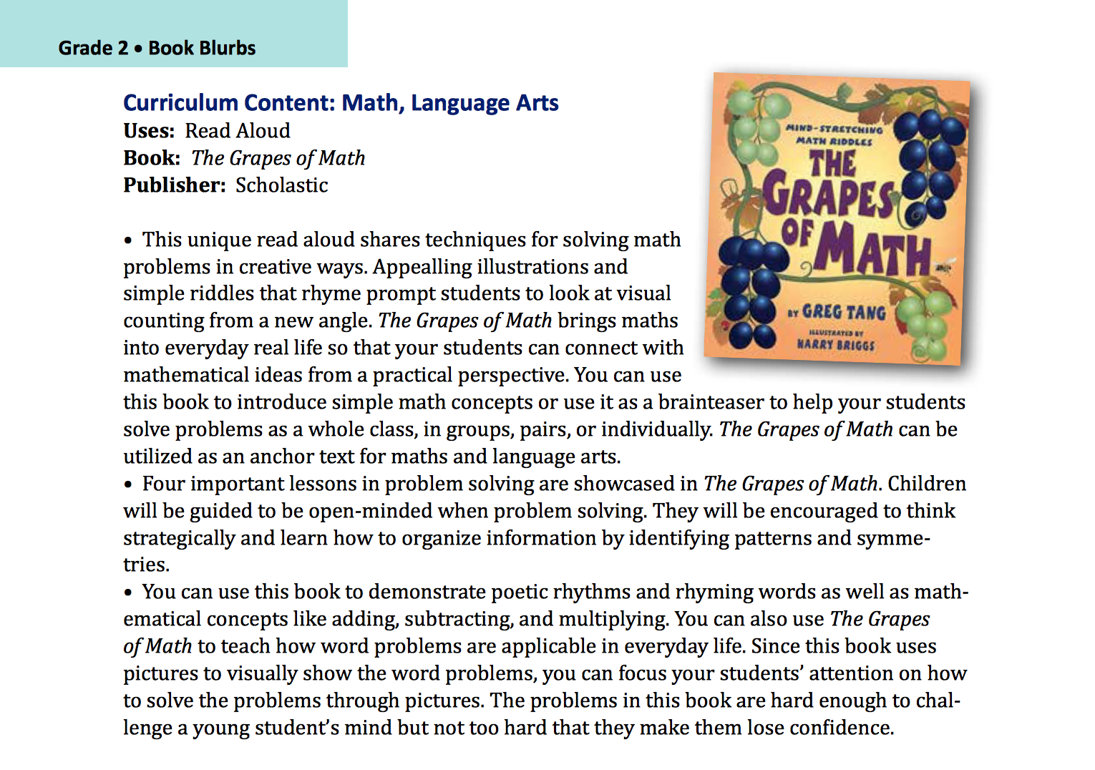
Notes:
Book Blurbs show what curriculum content the book can be used for along with its uses and quick class activity suggestions that teachers can adapt for their students’ needs. Here is a page from the Grade 1 Book Blurbs. You can see how Fly Guy can be used for a lesson on rhyming, vocabulary building, and phonics as well as science content and Clifford the Big Red Dog can be integrated into a Social Studies lesson about sharing, playing fairly, and having respect. *Another Book Blurb from Grade 2 is the Grapes of Math, a book that can be used to teach Maths concepts adding, subtracting, and multiplying in word problems applicable in every day life and Language Arts through poetic rhythms and rhyming words.

Slide 17
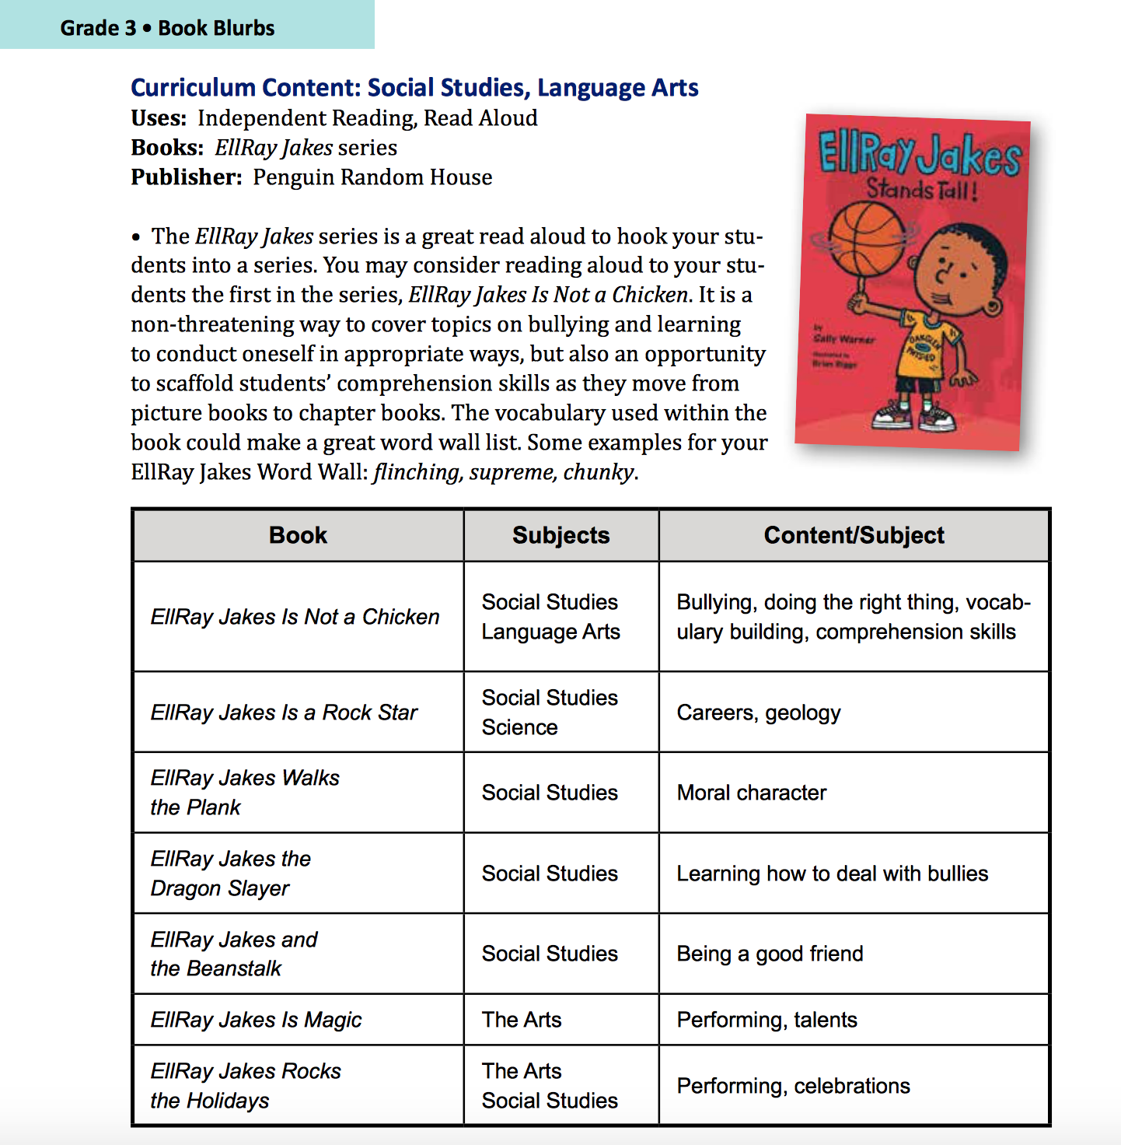
Notes:
*Keep in mind that the same book can be used to teach many different subjects, and Book Blurbs in this section can help you with this!

Slide 18
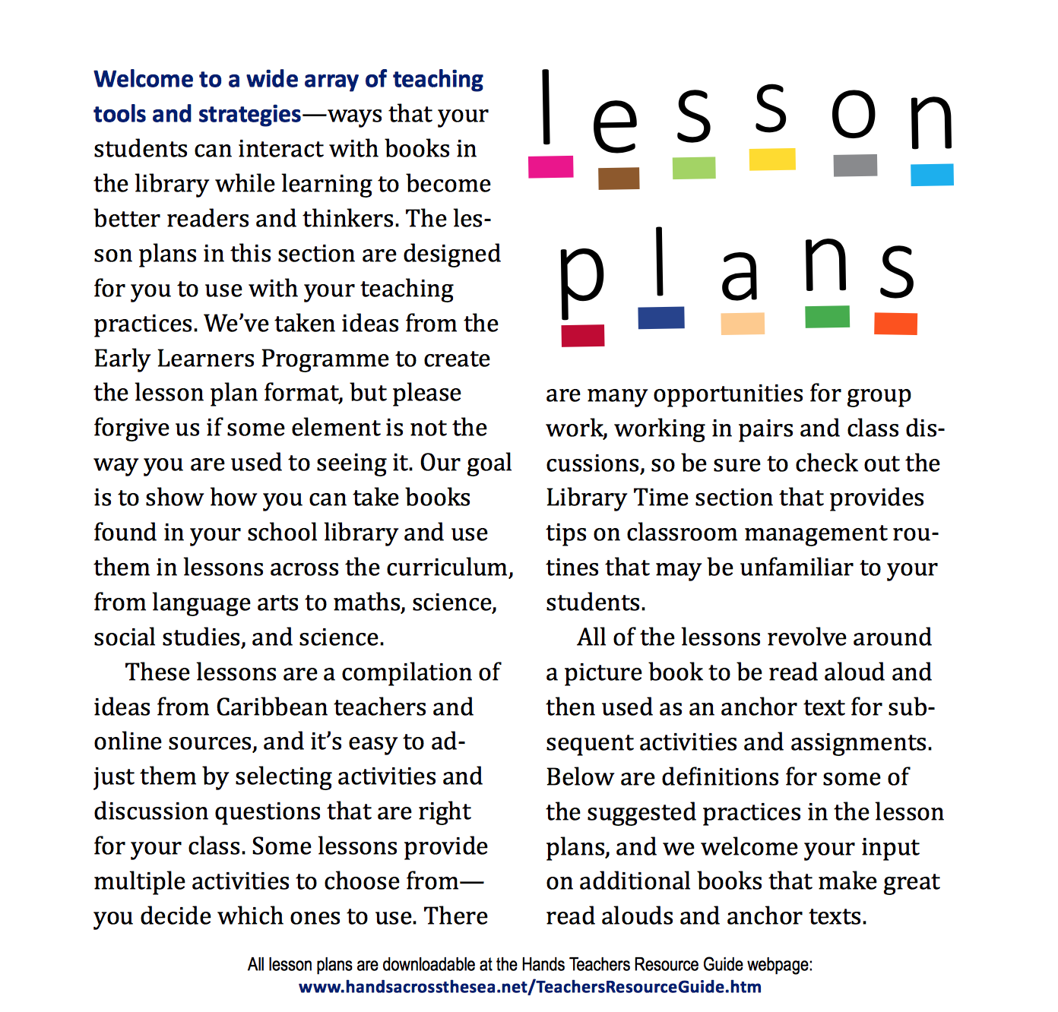
Notes:
*This fourth section of the Teachers Resource Guide is called Lesson Plans, and this is by far the largest section.

Slide 19
Notes:
*It is organized by grade level, with five lesson plans for each grade K-3. The lesson plans have suggested activities that teachers can do with their students before reading, during reading, and after reading the books listed here. Let me show you a few examples!

Slide 20
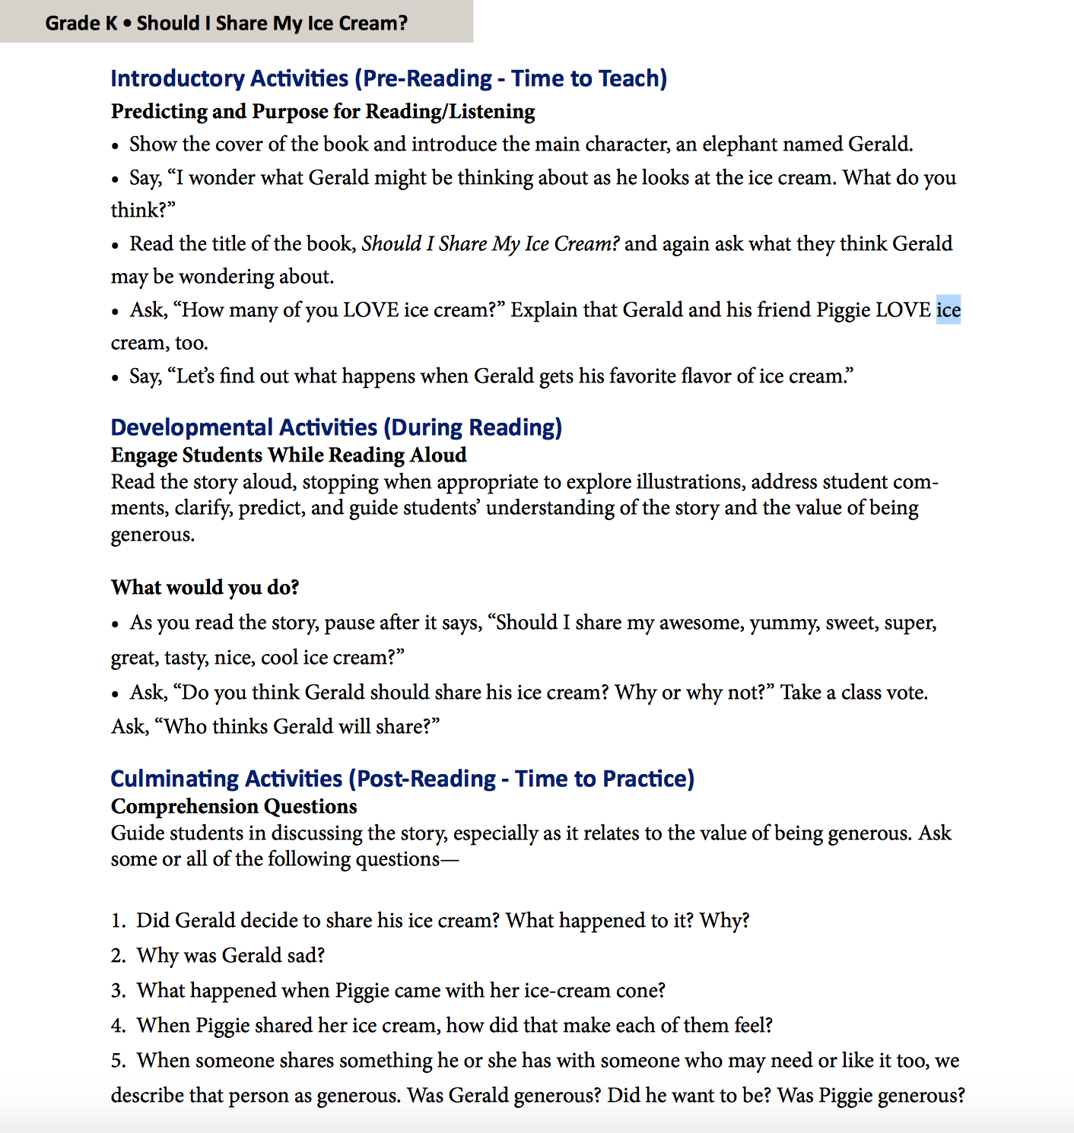
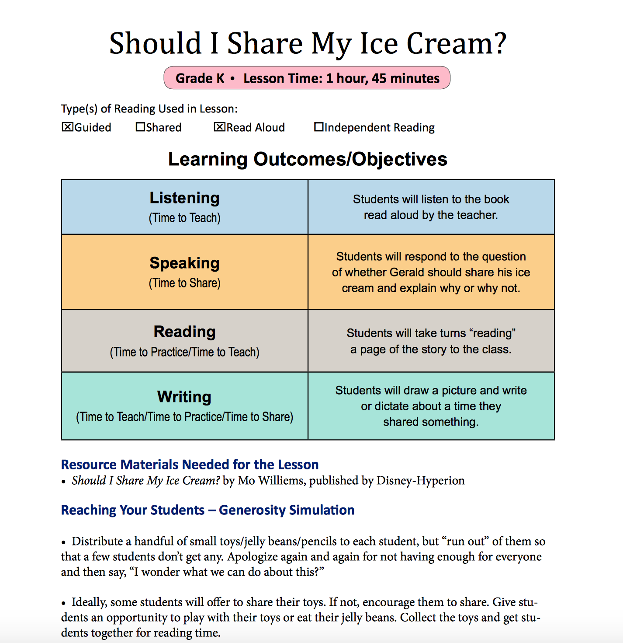
Notes:
*In a Grade K lesson plan that corresponds to the book Should I Share My Ice Cream? you can see that the learning objectives are listed, showing how the teacher can cover listening, speaking, reading, and writing skills in this one read-aloud lesson. *The lesson plan also gives suggestions for pre-reading activities like predicting and setting a purpose for reading and listening. *Developmental Activities during reading engage students while reading aloud with specific questions or activities within the story’s text that can enable students to think while they read or listen. The Culminating activities are post-reading and provide time for students to practice skills like responding to comprehension questions.

Slide 21
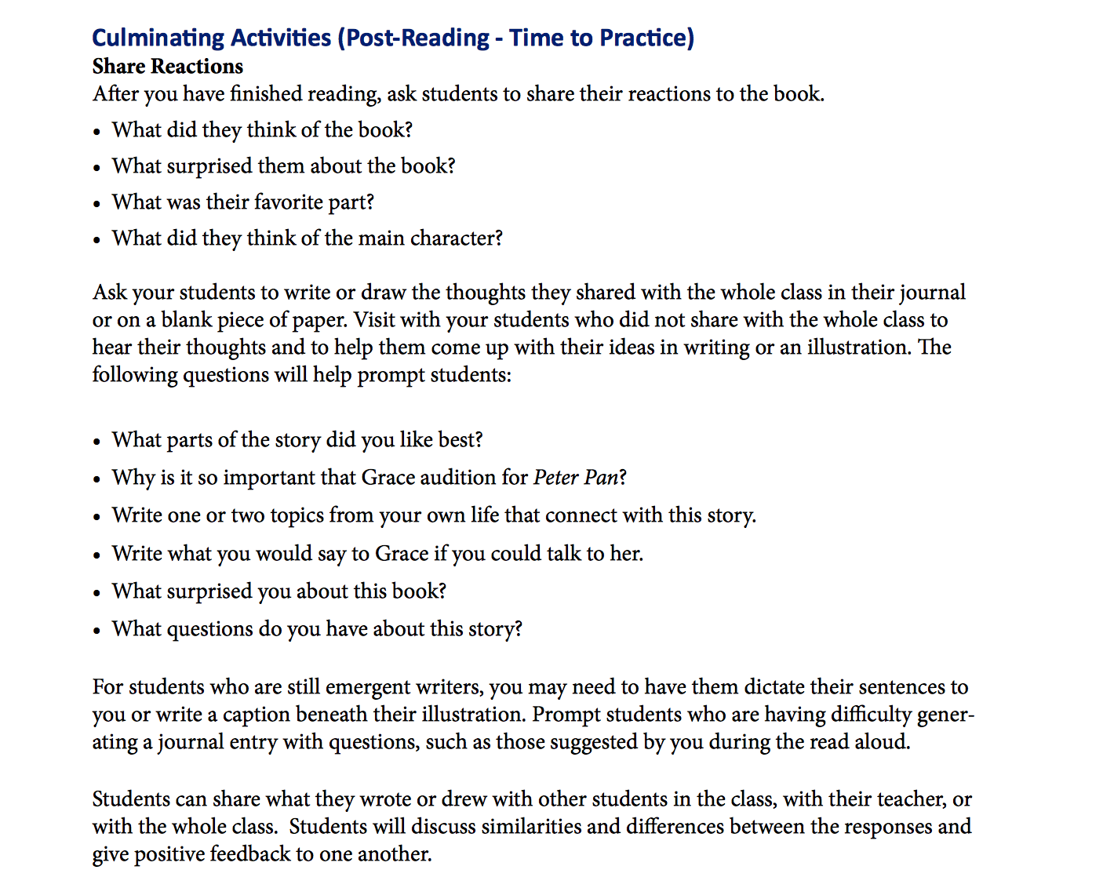
Notes:
*For this Grade 1 lesson plan that goes along with a book called Amazing Grace, you can see some questions to encourage students to share their reactions to the book and get a whole class discussion going.

Slide 22
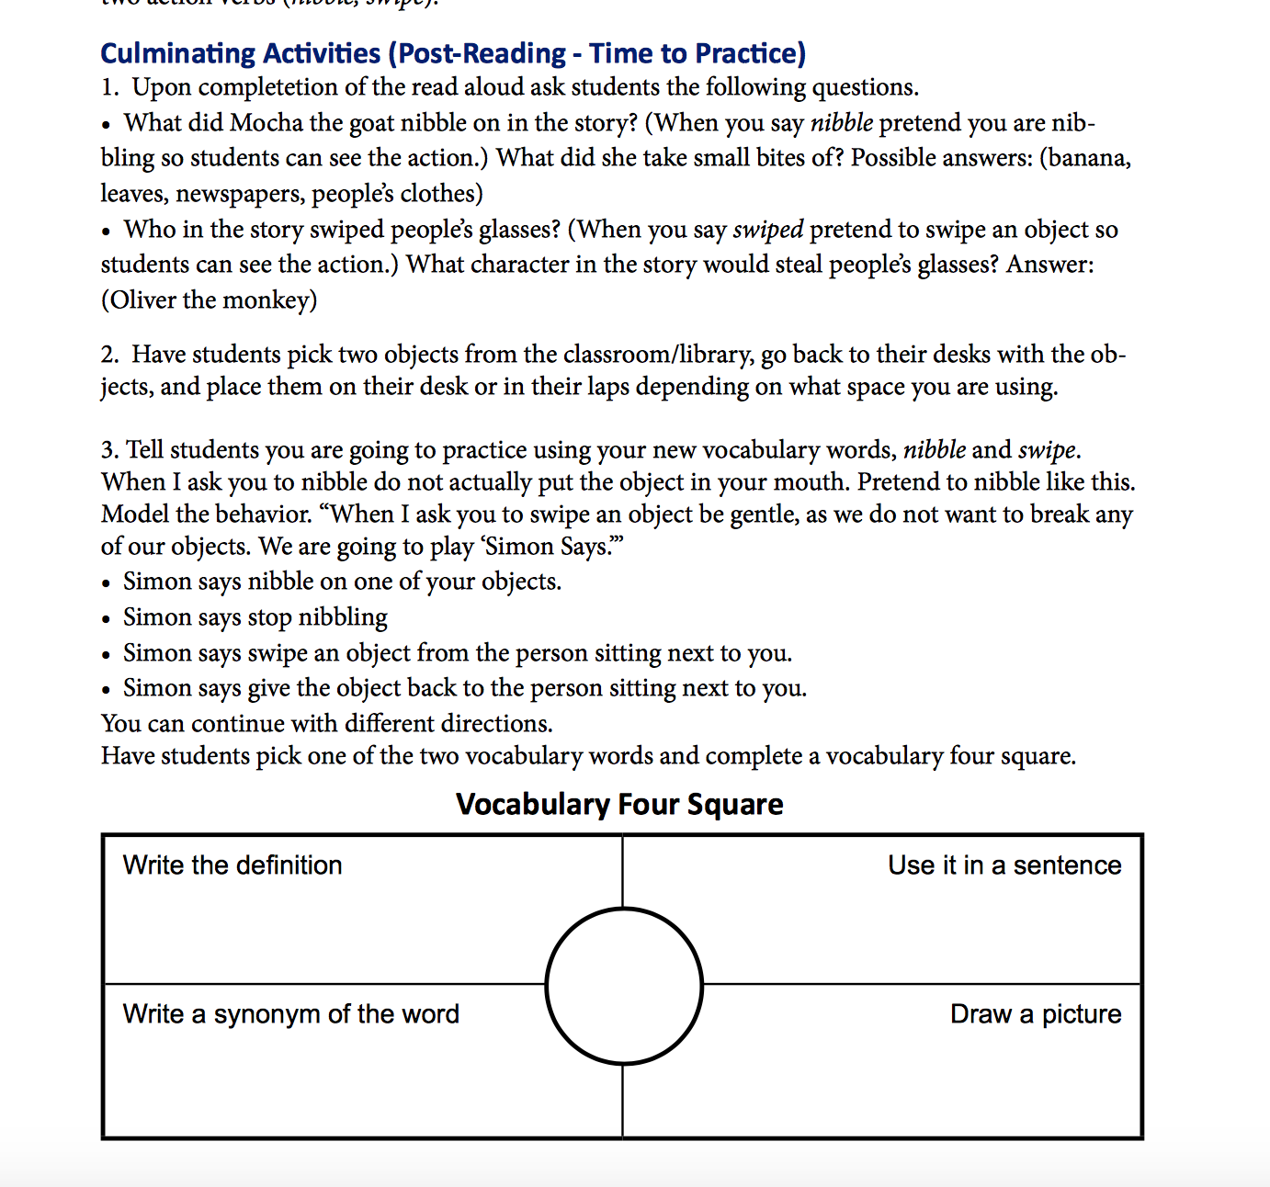
Notes:
*In another lesson plan about a book called Oliver and Friends, this culminating activity has an easy Vocabulary Four Square that teachers could copy up onto their chalkboards and use as a graphic organizer for students to learn from.

Slide 23
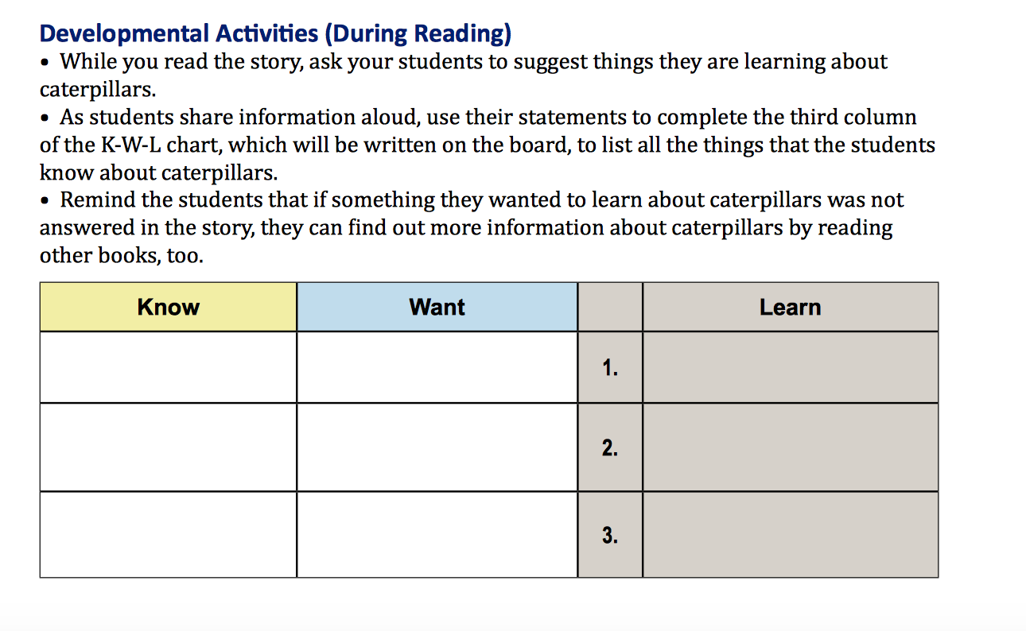
Notes:
*The suggestions given in the During Reading activities for the Very Hungry Caterpillar include a K-W-L chart, something simple teachers can use with any book to list all the things that the students already know about caterpillars, want to know before reading, and then what they learned about caterpillars while they are reading or listening to the book.

Slide 24
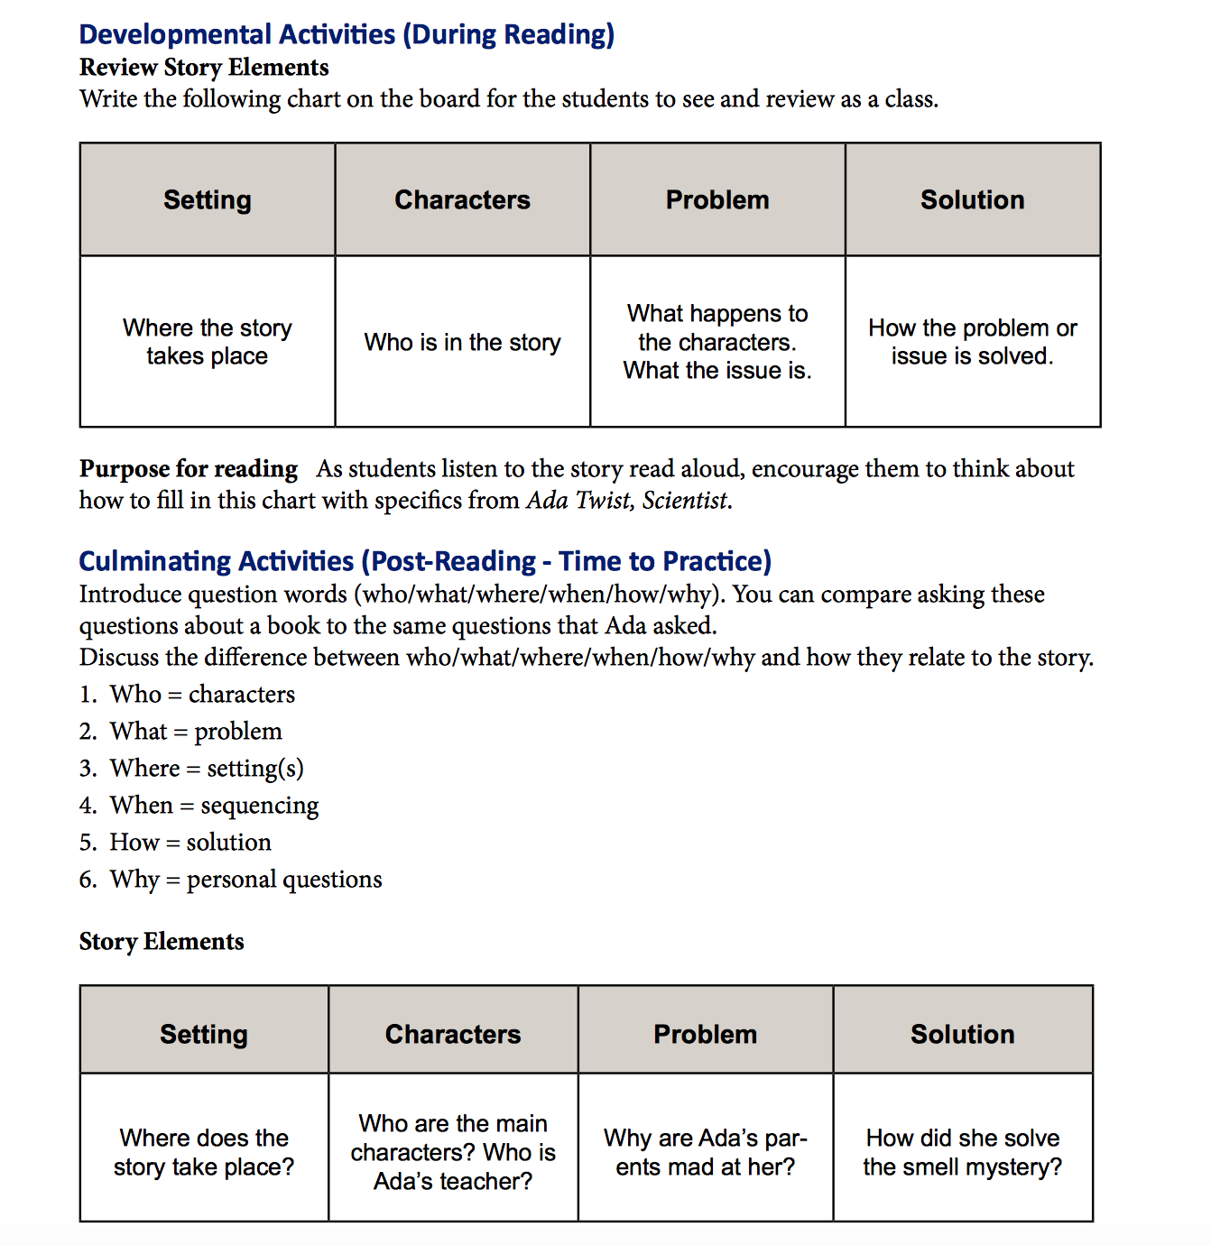
Notes:
*Creative ideas for how to review story elements with second grade students using the book Ada Twist Scientist are shown in this lesson plan. Not all the activities given in the lesson plans have to be done with the students—teachers can use some, and leave others. This resource is for teachers–so they can pick what they think will work best! The goal is to encourage teachers to start using more books in their lessons!

Slide 25
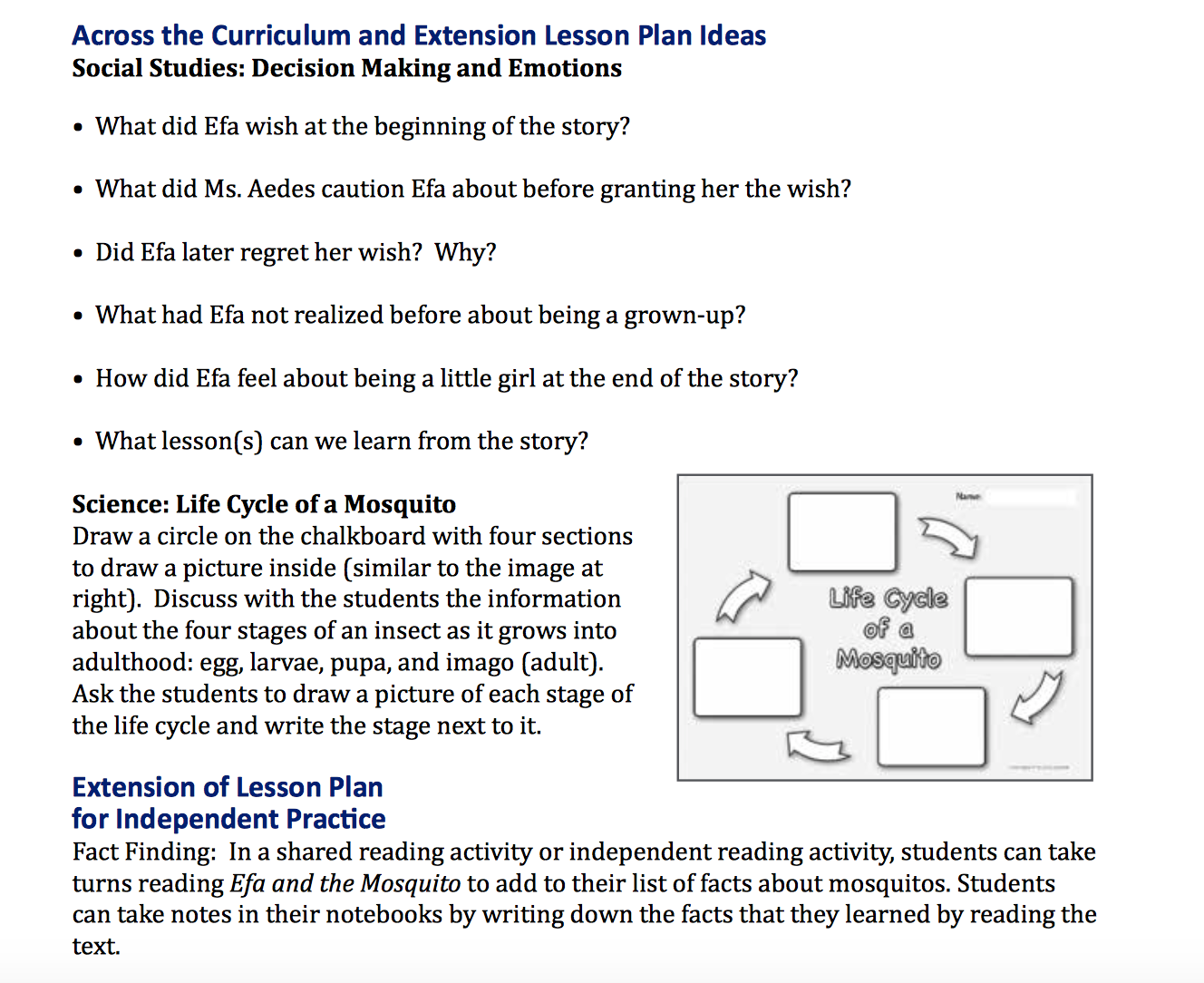
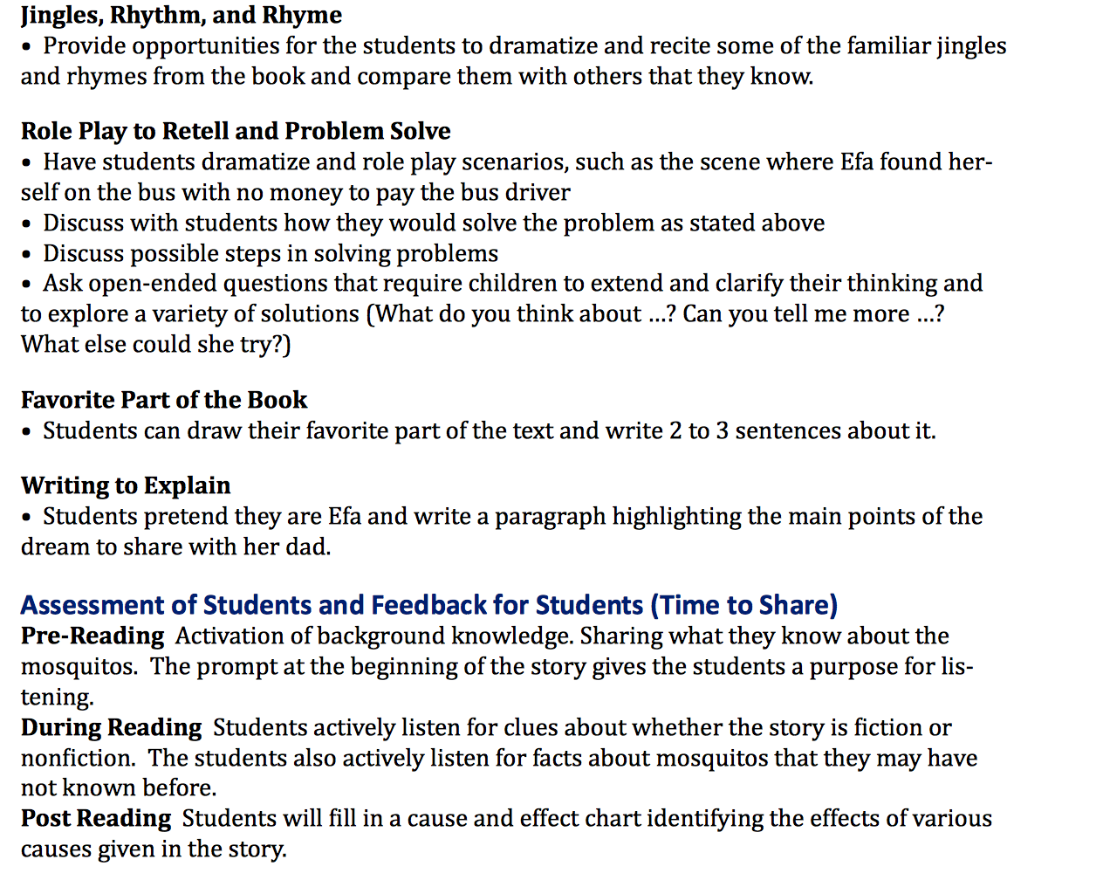
Notes:
*You can see how for this lesson plan about Efa and the Mosquito there are many short lists of activities that the teacher can choose from while teaching from this book! Many of the suggestions correlate directly with a teacher’s curriculum, not just for Language Arts but also for science and social studies—even math too!

Slide 26
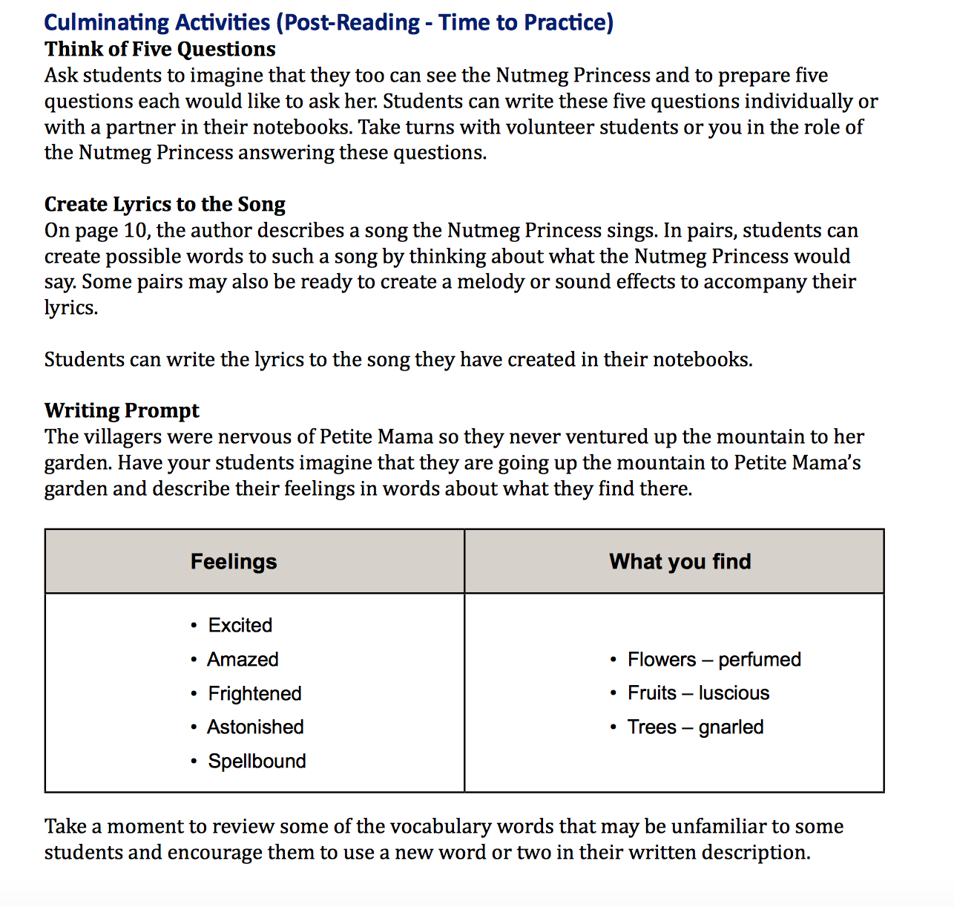
Notes:
*You can see in this 3rd grade lesson plan about the Nutmeg Princess that lots of writing prompts are given for students to practice their creative writing skills. If teachers have other great lesson plan ideas that goes along with a book that is in their school’s library, then we encourage teachers to write it up and add it to this section for all of the other teachers at their school to benefit from! The Lesson Plans section of the Teachers Resource Guide is intended to be added to. That is why it is in a 3-ring binder! I am going to pause now and see if there is any feedback or questions you have.

Slide 27

This final section is full of lists of books sorted into various categories that will help teachers choose which titles you may want to teach from.
Notes:
*The final section of the Teachers Resource Guide is called Library Resources and is full of lists of books sorted into various categories that will help teachers choose which titles they may want to teach from.

Slide 28
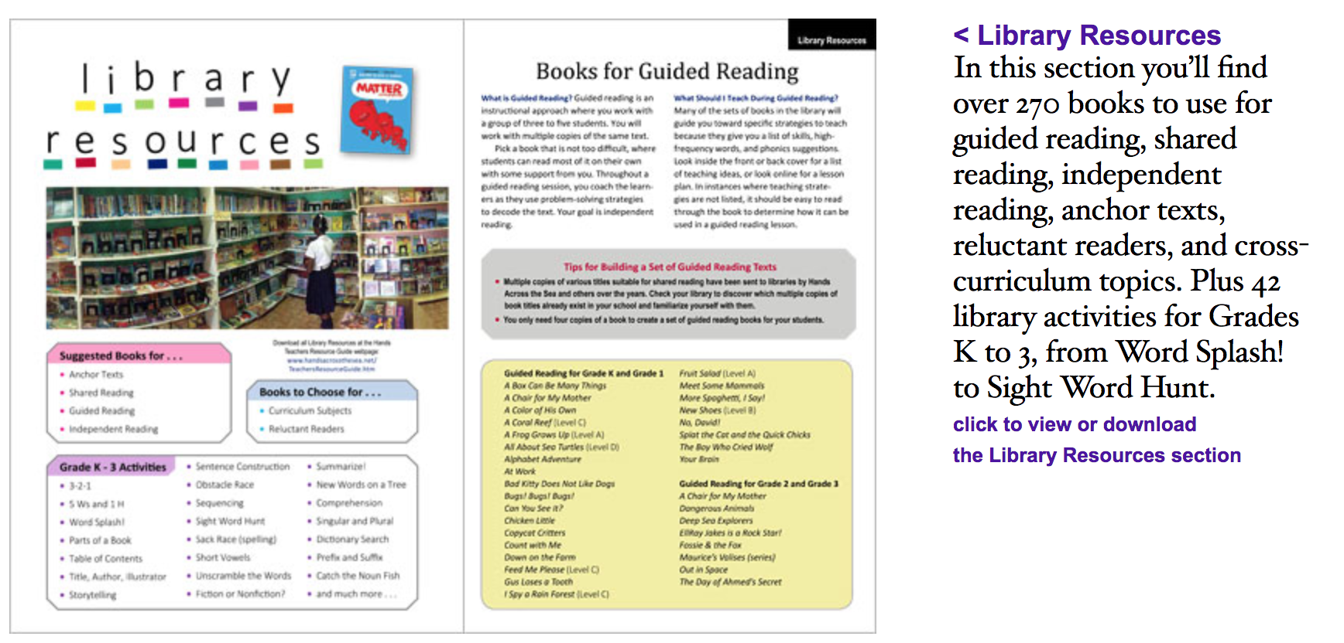
Notes:
*This section is meant to be used as a reference. Teachers can flip through it and scan the lists to find the best book for teaching.

Slide 29
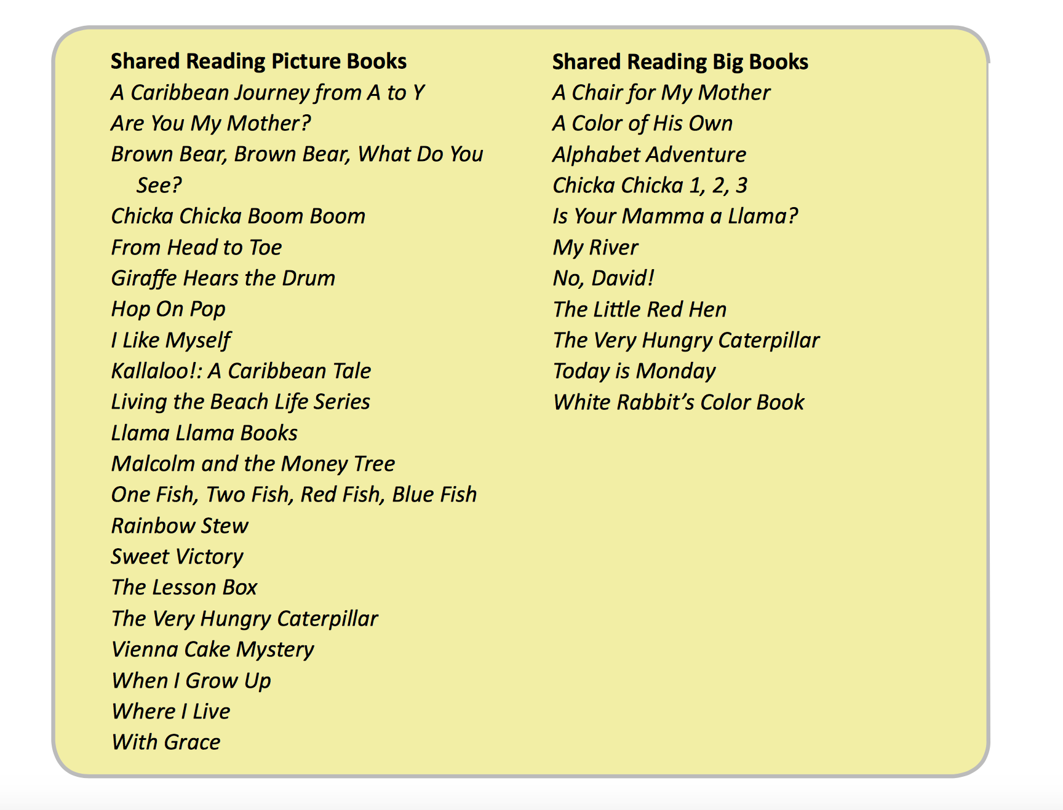
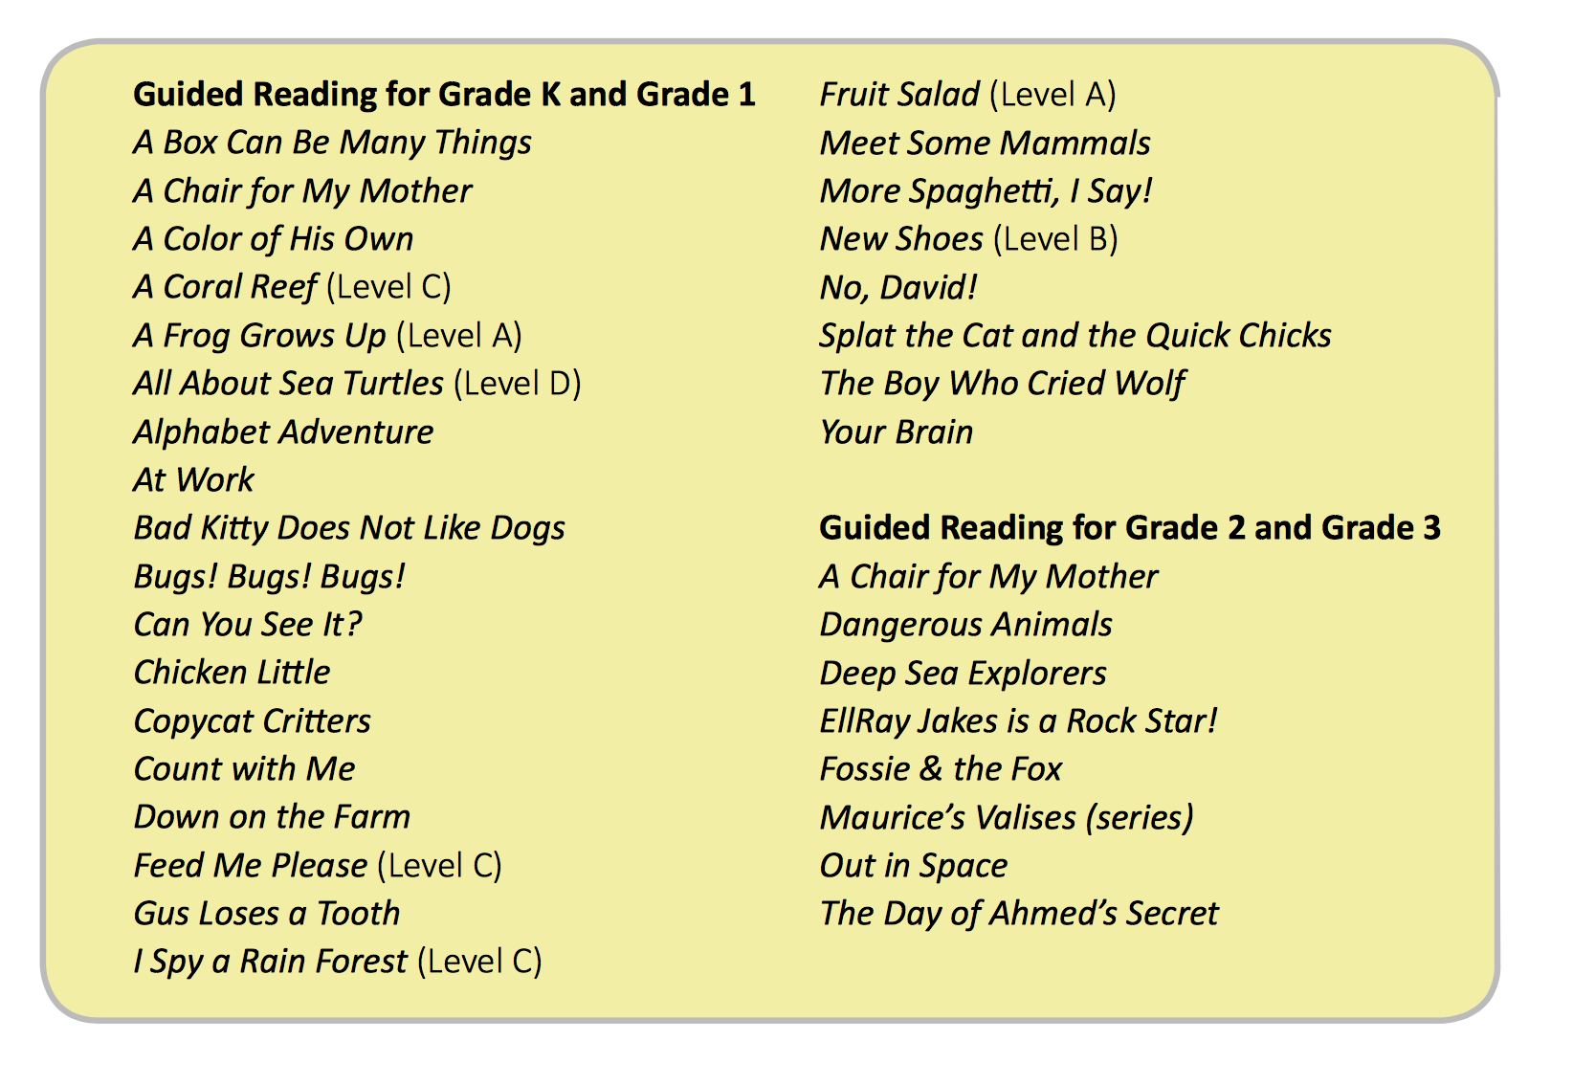
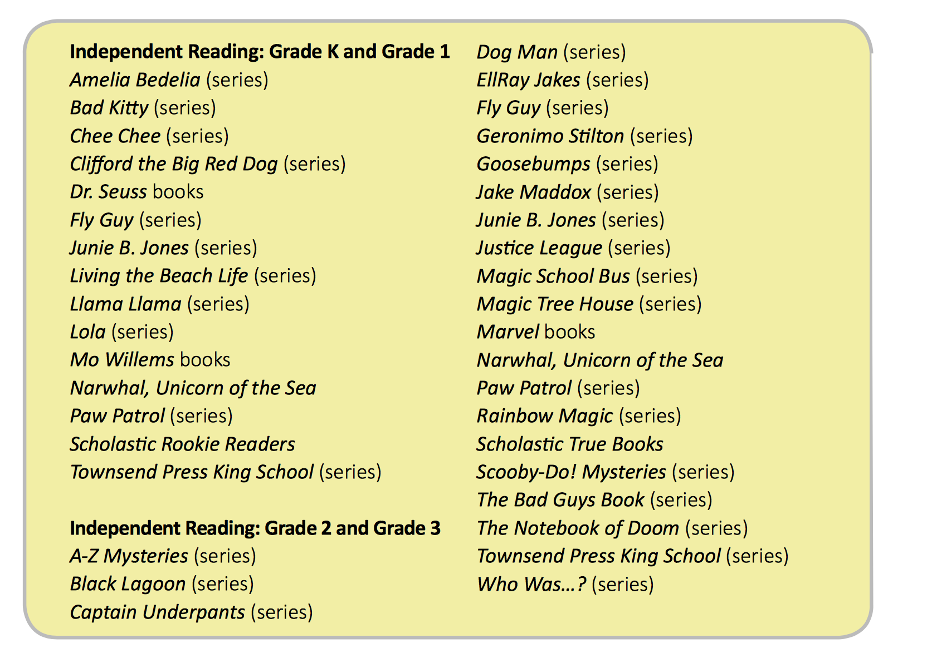
Notes:
Here is a list of books suggested to use for shared reading. Tips for building a set of shared reading texts are also provided. Here is a list of Guided reading books divided into Grade K and Grade 1 as well as guided reading books for grade 2 and 3. Suggestions for independent reading are listed here as well.

Slide 30
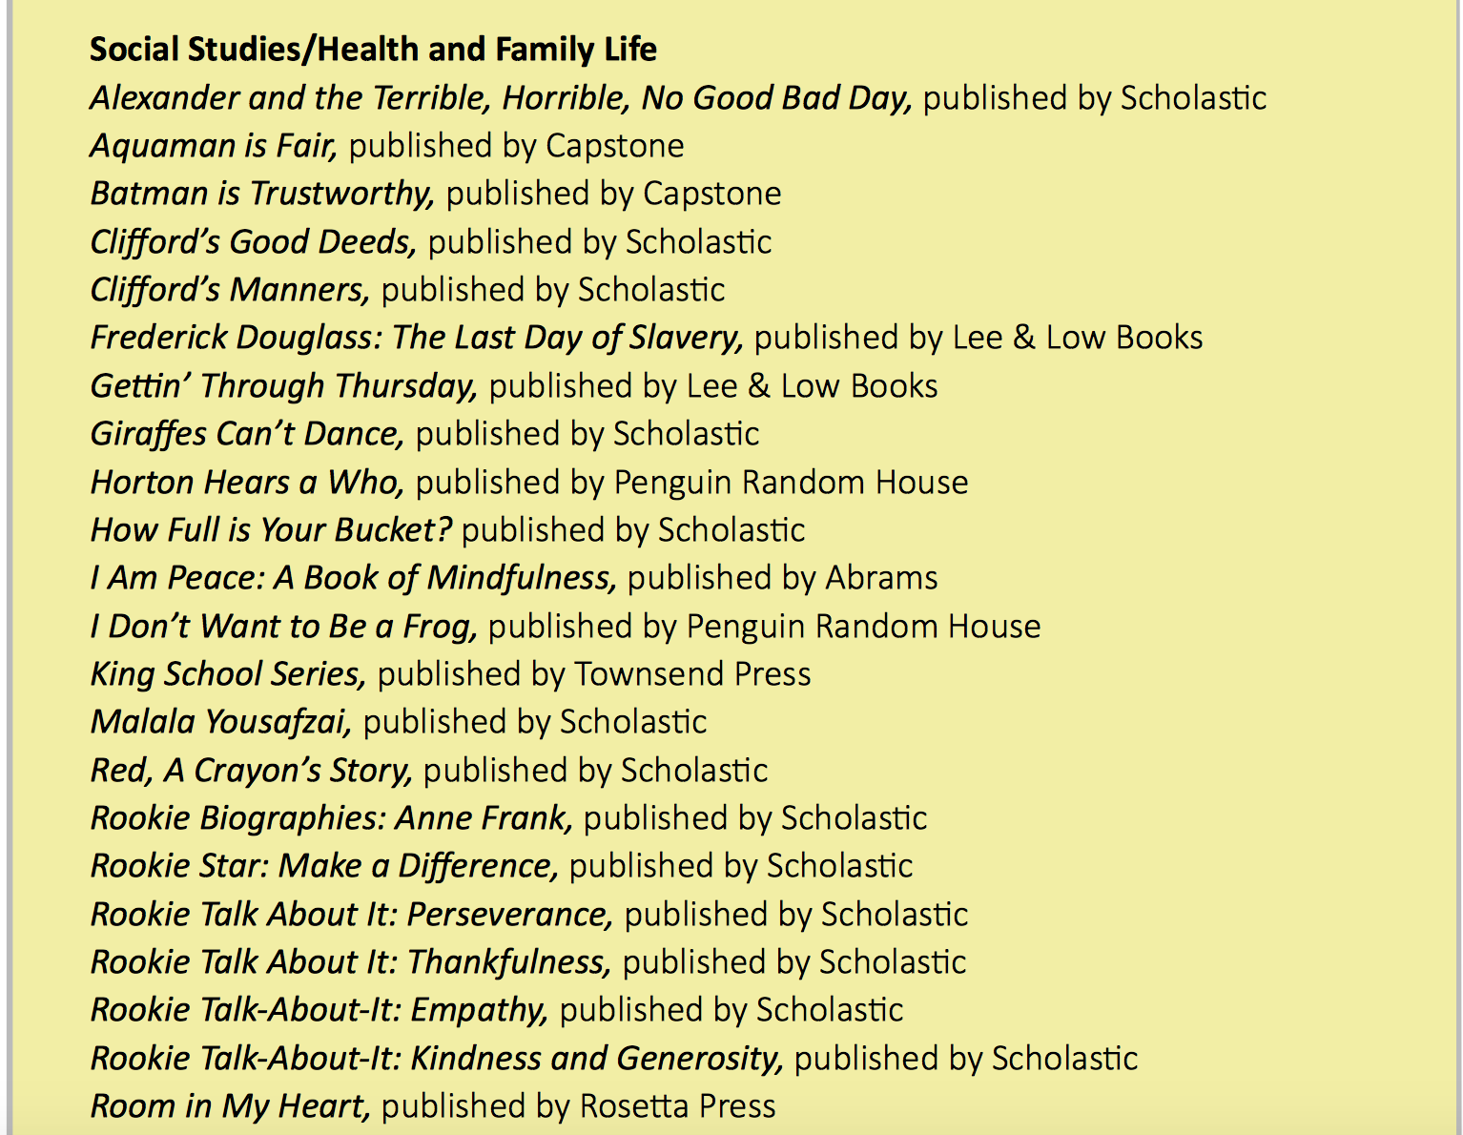
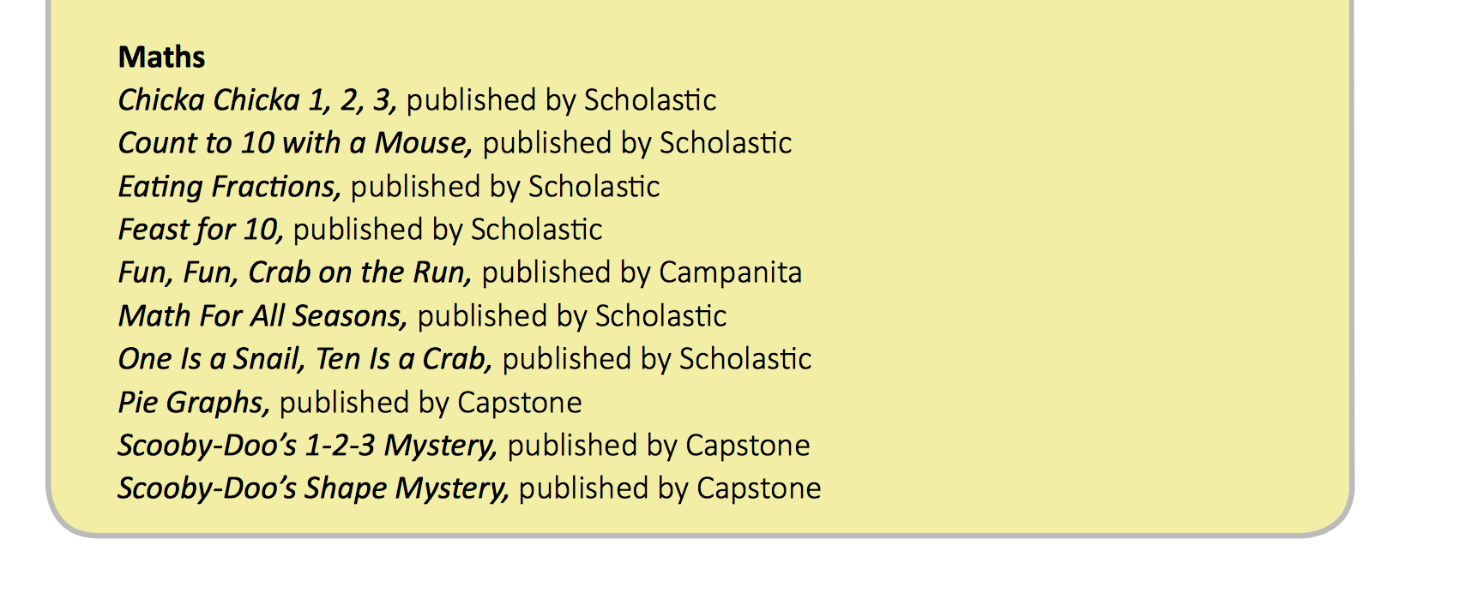
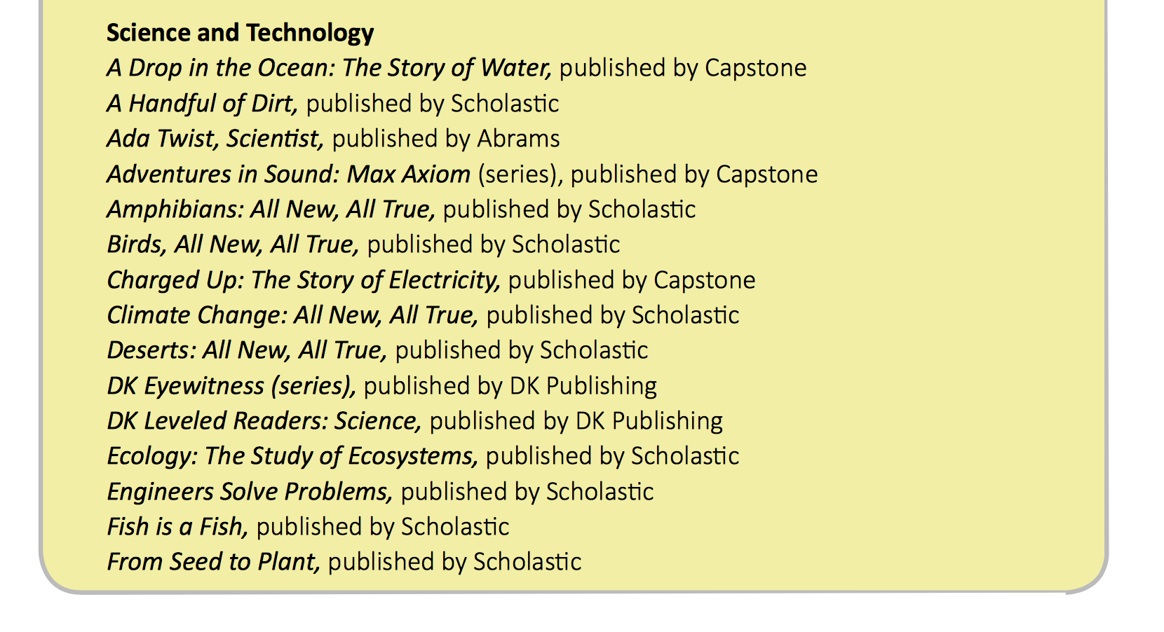
Notes:
This section also lists books sorted by subjects within curriculum, so teachers can choose picture books that correlate with the content they are teaching in science, math, or social studies and pair read aloud texts with their curriculum content!

Slide 31
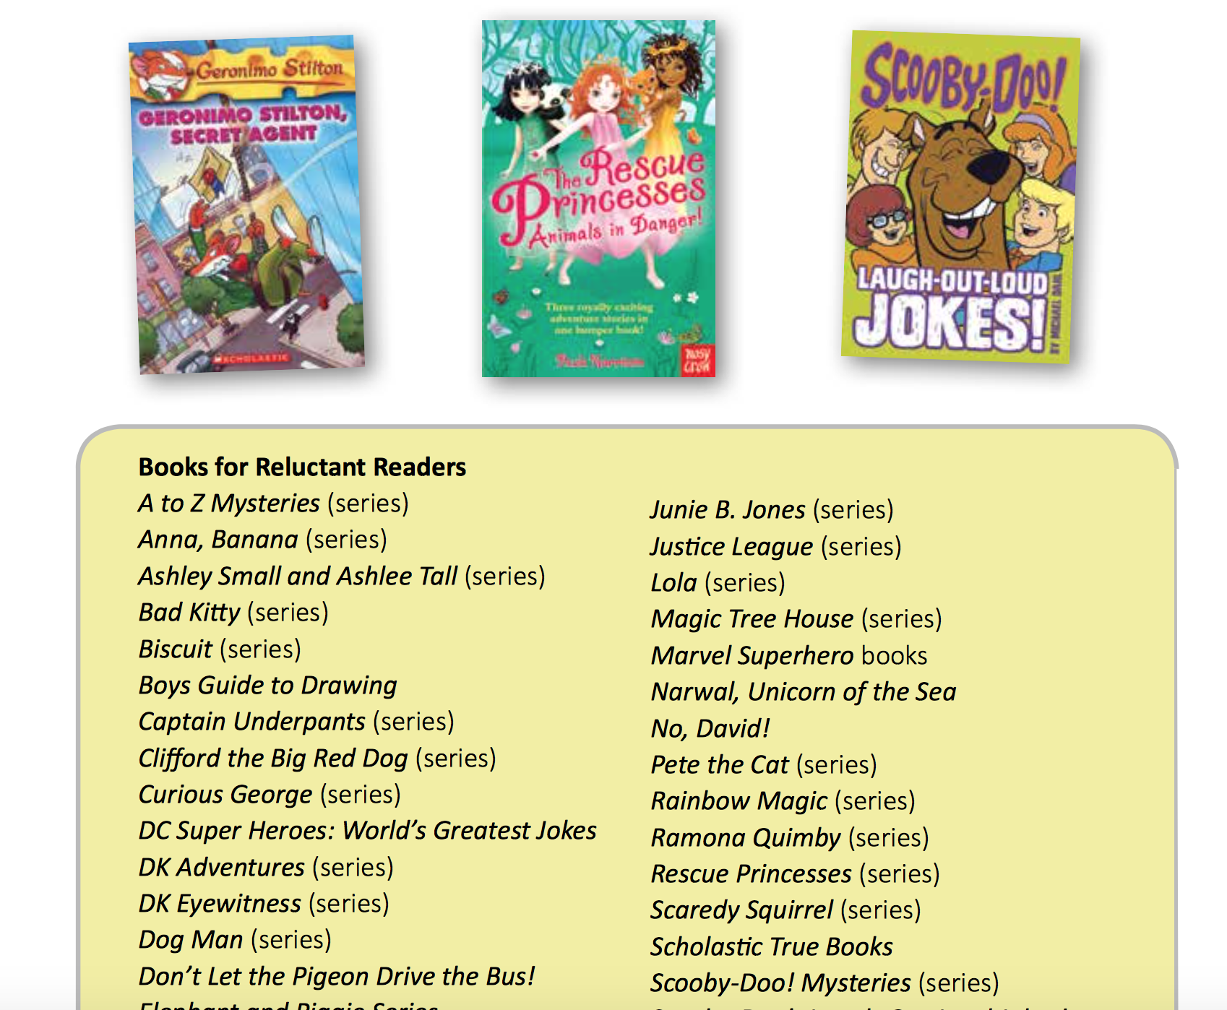
Notes:
One page I want to draw your attention to is the list of book recommendations for reluctant readers. We all have those students who just aren’t interested in reading—try a few of these titles on them! These books just might change their minds about reading.

Slide 32
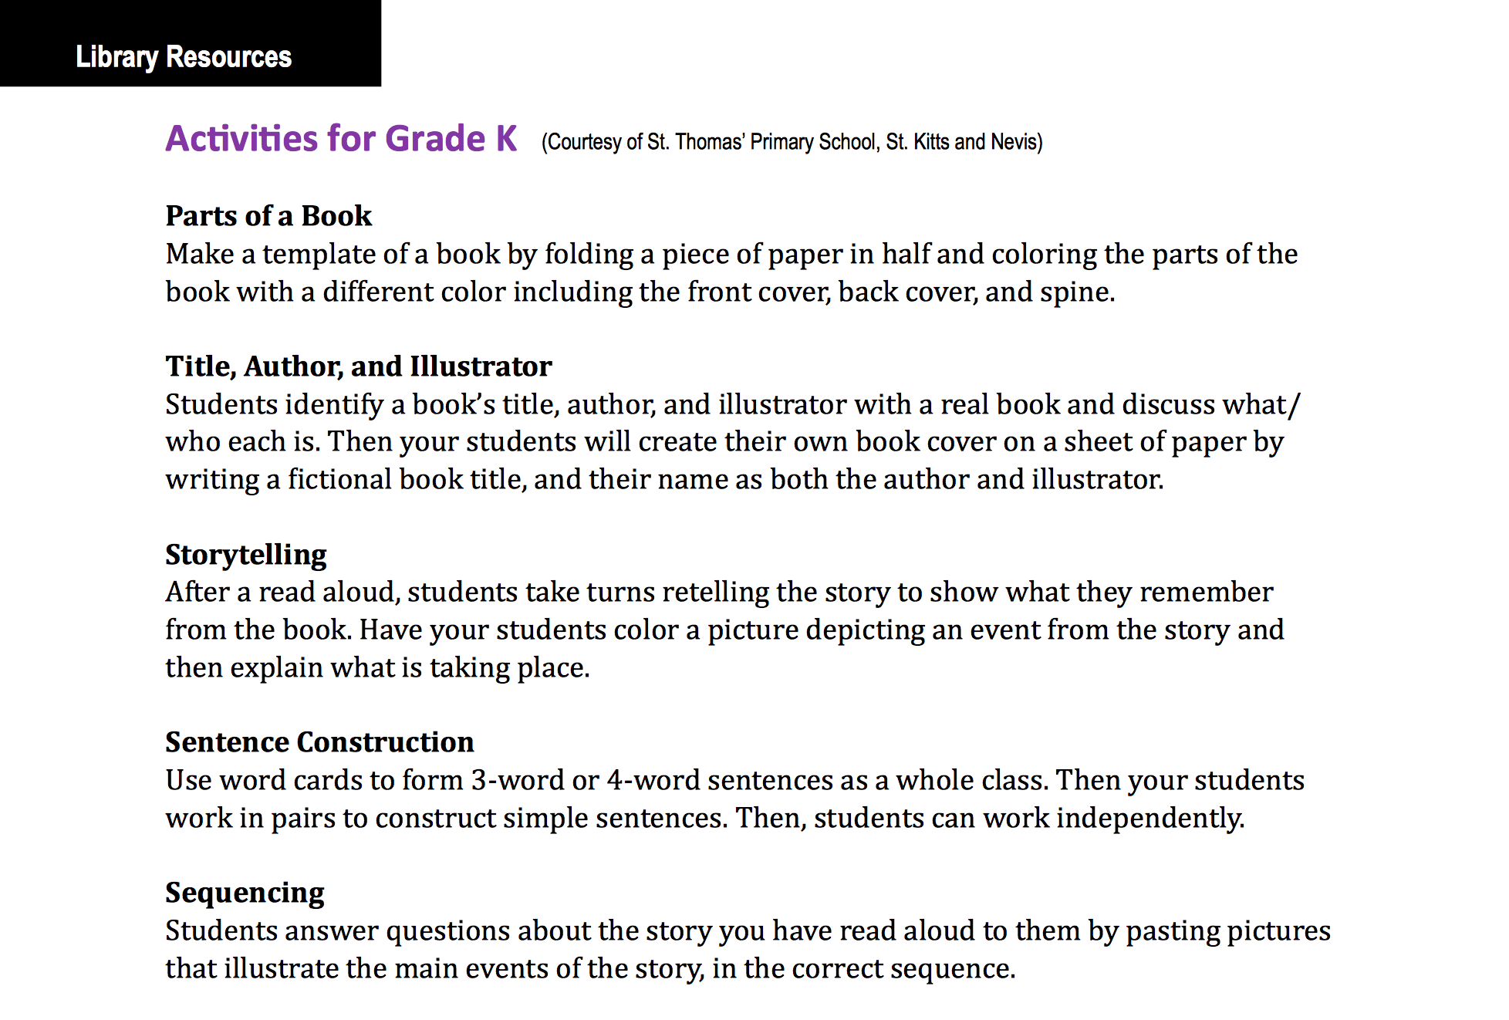
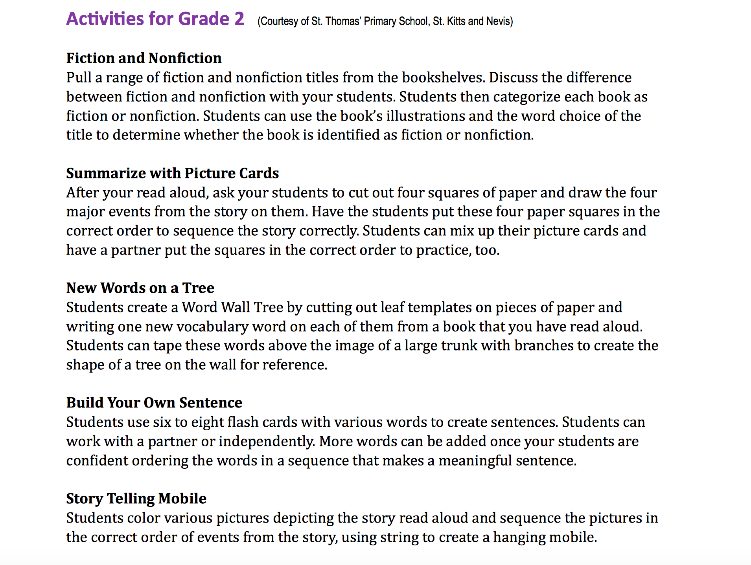

Notes:
The Library Resources tab also includes a section called “Literacy Activities.” *These are designed to make the library come alive, and teachers can use them in their classrooms to make Language Arts lessons more hands-on and fun! *These activities are sorted by grade level and cover various literacy concepts for students to practice a myriad of skills that coincide with the curriculum taught.

Slide 33
Want your own copy?
The Teachers Resource Guide is available for download on our website: www.handsacrossthesea.net!
Notes:
The Teachers Resource Guide is meant to be used—not kept on a shelf in the library. So if you or any teacher you know wants their own copy, it’s available for FREE to download from Hands Across the Sea.net.

